Slide 1
DevOps Institute is dedicated to advancing the human elements of DevOps success. As a global member-based association, DevOps Institute is the go-to learning hub connecting IT practitioners, education partners, consultants, talent acquisition and business executives to help pave the way to support digital transformation and the New IT.
Our vision is to help advance careers and support emerging practices within the DevOps community based on a human-centered SKIL Framework, consisting of Skills, Knowledge, Ideas, and Learning.
All the work – including accreditations, research, events, and continuous learning programs – is focused on providing the “human know-how” to modernize IT and make DevOps succeed.
Education Partners of DevOps Institute represent an exclusive group of organizations who have gone through the rigor and investment in supporting the advancement of the Humans of DevOps. Partners represent a crucial pillar in enabling individuals & organizations to equip them for DevOps success.
Accredited Instructors of DevOps Institute bring to life the course content & equip learners with the know-how to not only pass the examination, but also provide them with the knowledge and tools to be more successful when they return back to work after the course.
All Accredited Instructors have gone through a vetting process with DevOps Institute & have successfully passed the examination for the course they will be delivering.
S K I L
Quick Stats
>25,000
Certified Learners
11
Competency-based Certification Courses
More Than
190
Hours of Learning Materials (the most in the market)
Industry leading experiential learning solutions
Certifications represent the most hireable, desirable, & success-oriented DevOps roles today
Annual Upskilling Enterprise DevOps Research Survey
Member of the CD Foundation to represent the human elements of DevOps
Community
The DevOps Institute community of over 52,000
members provides individuals with access to:
Online Learning
eBooks
Career Center
SKILbooks
Podcasts & Blogs
Networking with community
Industry Research & thought leadership
Represent, Advocate & Enable
DevOps Institute invests significantly to raise market awareness of the importance of education by hosting & participating at industry events globally including:
SKILup Hours
Monthly SKILup Days
Global SKILup Festival
Local & Virtual SKILup Chapter Events
DevOps Days - Globally
INSERT ADDITIONAL PARTNER DETAILS
www.devopsinstitute.com
Notes:
Trends in the Market
Enterprise customers are facing significant competition from agile start-ups
Address the well recognized skills gap for DevOps and digital transformation
UpSkilling programs and hiring for DevOps skills is growing

Slide 2
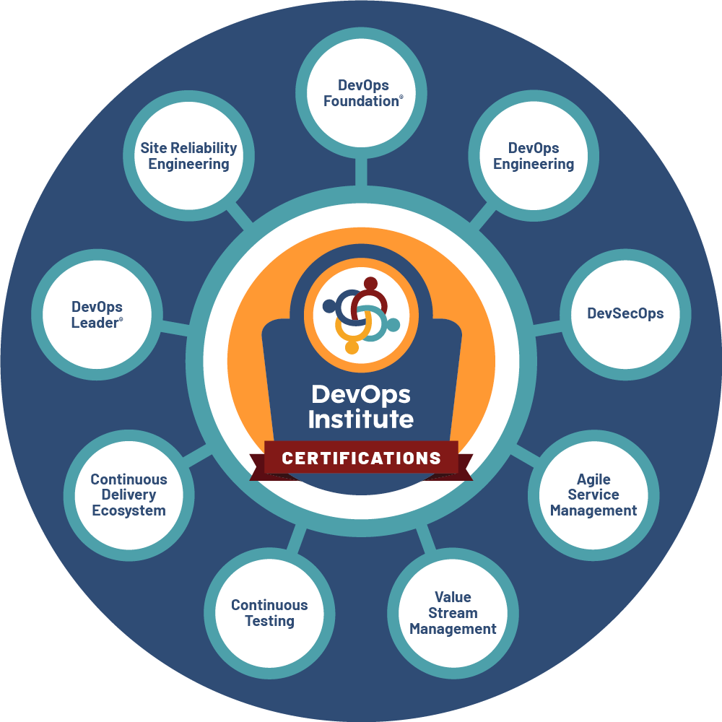
devopsinstitute.com
The SKIL Framework
Represents the DevOps Institute holistic ecosystem and stands for Skills, Knowledge, Ideas, and Learning that will continue to grow as DevOps Institute continues to develop and curate the industry’s best thinking and make it readily available to the DevOps community. The thirst for DevOps skills and knowledge is incredibly strong and DevOps Institute is the go-to hub to obtain this knowledge.
The SKIL Framework is dedicated to advancing the human elements of DevOps.
The Framework consists of:
Skills to develop career growth Knowledge for DevOps understanding Ideas to spark innovation and Learning based on DevOps know-how
Relevant Curriculum & Content:
Curriculum is based on research, and the most up-to-date and relevant resources through a collaborative body of knowledge
Recognized industry thought leaders and subject matter experts
Conferences - SKILup Days, DevOps Enterprise Summit, DevOps Days, and many more
Videos and webinars
Podcasts, blogs, and articles
Case studies
Role-Based Approach
We focus on the most modern competencies required by organizations adopting DevOps and these are hireable skills:
Certification Course Topics:
DevOps Foundation®
DevOps Engineering
Site Reliability Engineering (SRE)
DevSecOps
DevOps Leader®
Continuous Delivery Ecosystem
Continuous Testing
Agile Service Management
Value Stream Management (VSM)
INSERT ADDITIONAL PARTNER DETAILS
www.devopsinstitute.com

