Slide 1
Virag Mody
Technical Writer
Gravitational
@Mad_Eye_Mody
virag@gravitational.com

Slide 2
How to Securely Access Compute Resources in Cloud Environments
WE’RE OPEN SOURCE
Notes:
Stick around for an applied demonstration with SSH Certificates
Virag Mody, writer. OSS co.
Teleport (Secure Access for Developers that doesn't get in the way.)
Gravity (Application deployments for restricted, regulated or remote environments.)

Slide 3
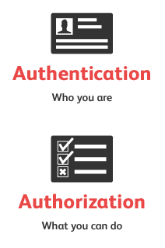
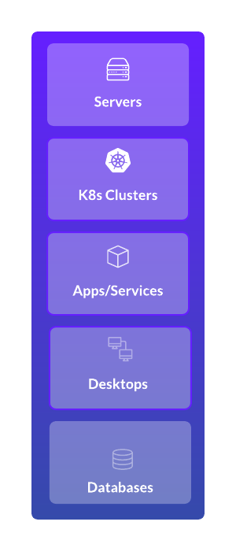
Breaking it Down
Secure Access
Compute Resources
Cloud Environments
Notes:
Compute Resources: Infrastructure resources that provide processing capabilities
Cloud: Hybrid, multi, VPC. Elastic envs that provide high availability & resiliency
Putting it all together: Authenticated and authorized access to elastic infrastructure

Slide 4
IT Stack is Abstracted and Decentralized
Notes:
Why does it matter? Nature of infrastructure continue to trend towards abstraction and decentralization
People as part of the IT Stack: Also spread out!
Important because current access policy enforcement was not designed to handle things that are “ephemeral”

Slide 5
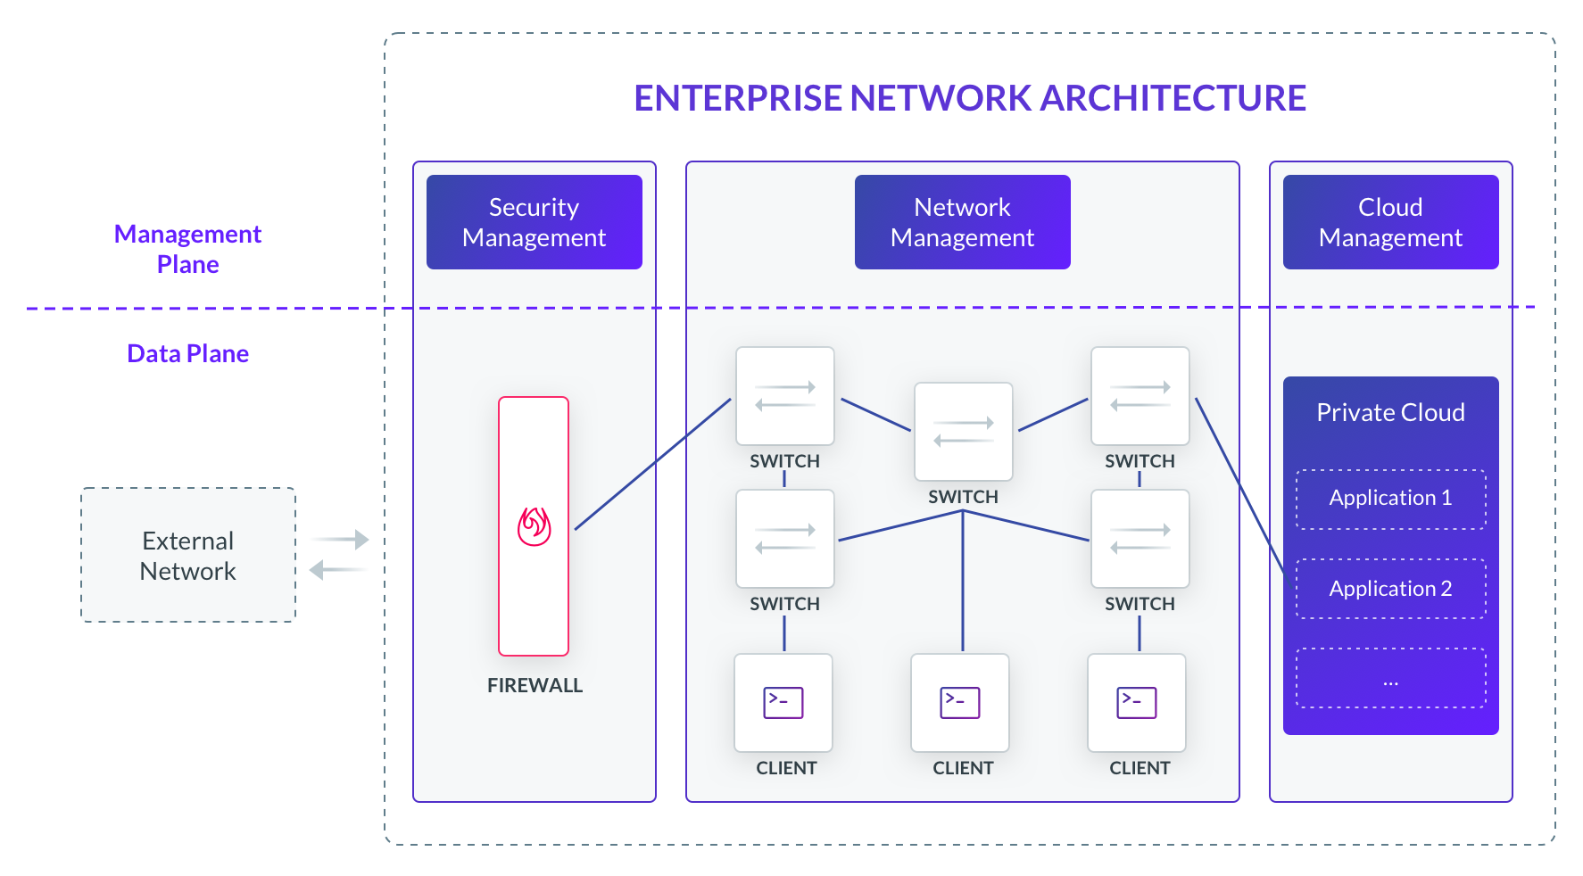
“Map is Not the Territory”
Notes:
Networks bear the burden of defense for permitted entry and access. Tasked with distinguishing trusted and non-trusted actors
An abstraction derived from something, or a reaction to it, is not the thing itself
When looking closer, see flaws:
Dynamic not Static Envs - IP addresses and ingress ports were reliable substitutes for behavior but dynamic infra = firewall, routing, ACLs and API rules need constant updating (can’t keep pace)
Internal protections - Difficult to track movement within networks
Secrets - Secrets generated to accessing critical infrastructure (tokens, keys, certs)
News mean to determine what is secure access
Networking is still necessary (ports won’t stop being scanned), but authentication and authorization should happen elsewhere

Slide 6
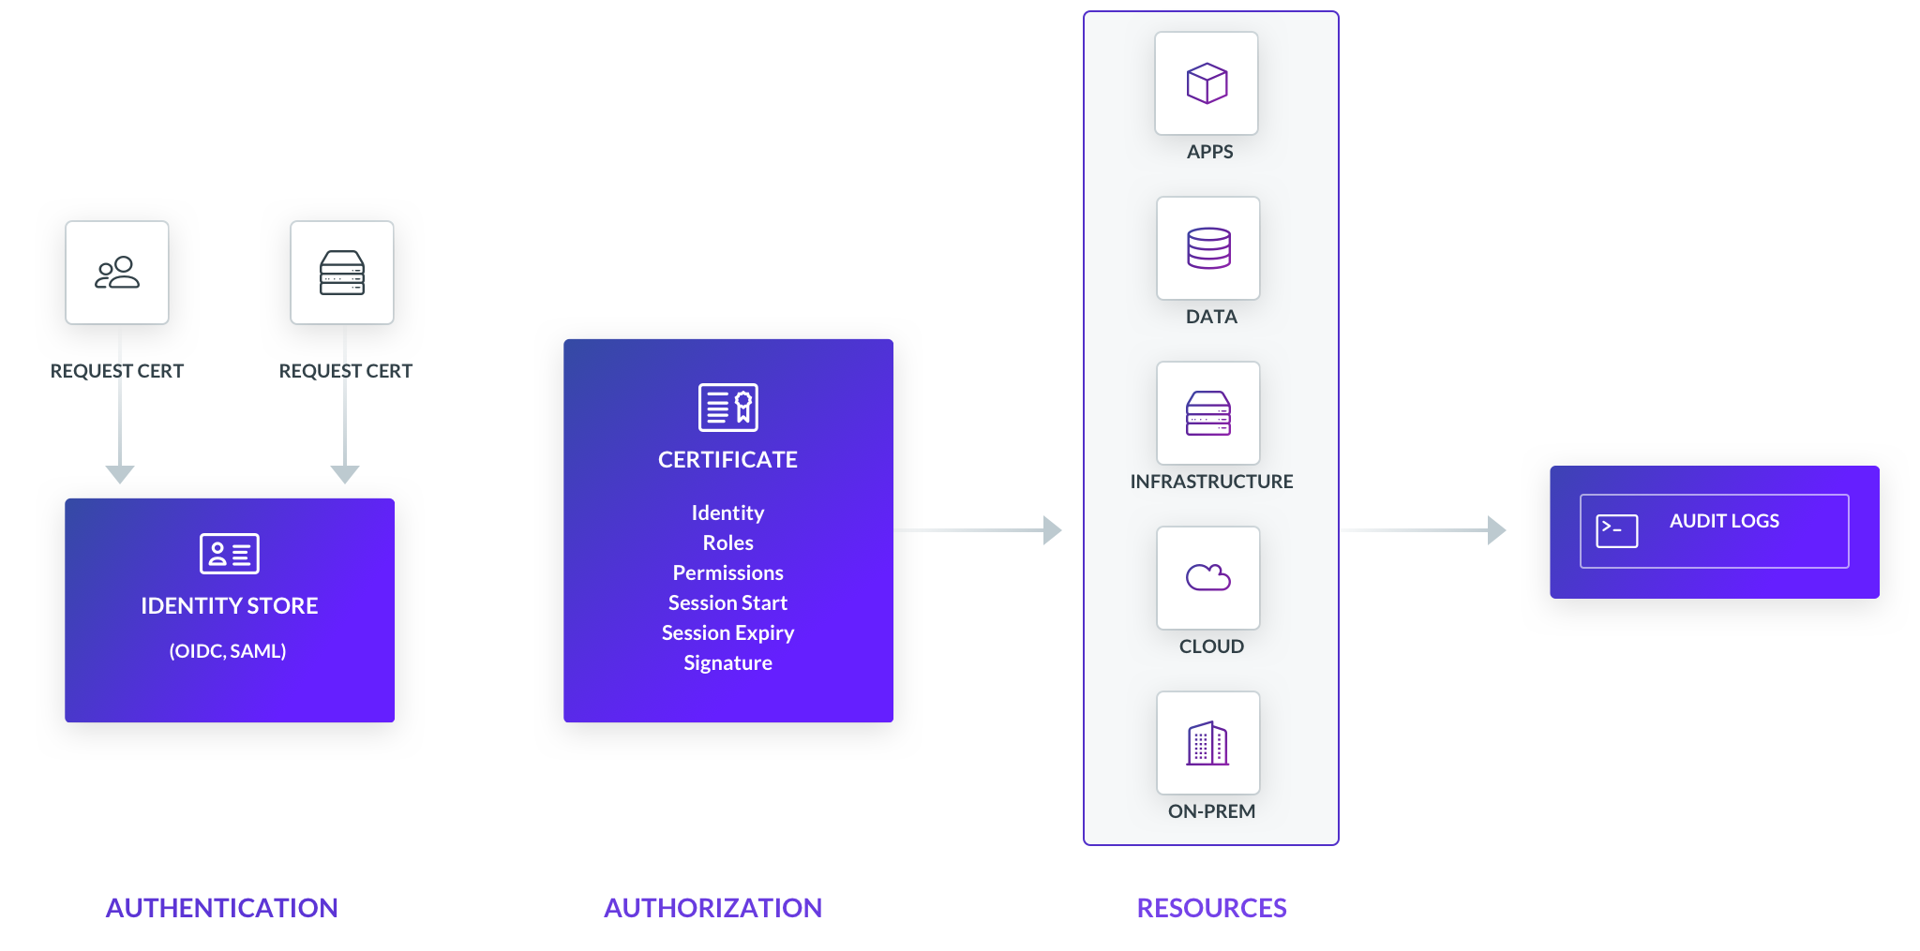
4 Principles
Base Decisions on Identity, not Secrets
Make it Easy to Use
No Private Networks, only Public
Centralize Audit and Logging
Notes:
Most important slide
Q: How to Securely Access Compute Resources in Cloud Environments
A: Separate the processes of authentication and authorization, and let the resources enforce access policies
How to go from [prev slide] to [current slide] - 4 principles that we follow
Base decisions on identity, not secrets
What do I mean? Grant access based on “who” not “what”
Why? Secrets are dangerous and powerful. Unreliably authentication, why? Because secrets can be stolen, identity cannot
Okta, active directory, keycloak, gluu - All popular central identity stores. SAML and OIDC make data reliable
Identity stores more information, secrets are impersonal. Can be used to create granular access policies
Group is an identity variable, imagine if groups didn’t exist in Linux
Applies to machines too!
Make it easy to use
Theme of this conference is DevSecOps, what’s more devsecops than security controls that developers actually like using?
Dev teams move fast and have constant deadlines. Making it difficult for them to use the tools they need will create backdoors.
Complicated and inconvenient infrastructure access creates a less secure state
Don’t trust private networks
Just as a rule, assume your network is public
More and more exposure to public networks
XaaS, APIs, public cloud
Target 2014 hack
Two advantages: solves the problem of having poor internal protections and forcing better use of encryption (rest, transit, and in use)
Centralize auditing and monitoring
Almost like a hygiene thing - bad logging habits are like bad git habits
Each progressive layer of abstraction produces more logs
Servers, vms, apps, containers, k8s clusters
Logs for ephemeral instances can easily be lost in the noise
Similar to identity, centralize where logs are aggregated, parsed, analyzed, and disposed
Advantages:
DevSecOps = teams working together. Information symmetry
Compliance (SOC, HIPPA, PCI, GDPR)

Slide 7
Why SSH Certificates?

Slide 8
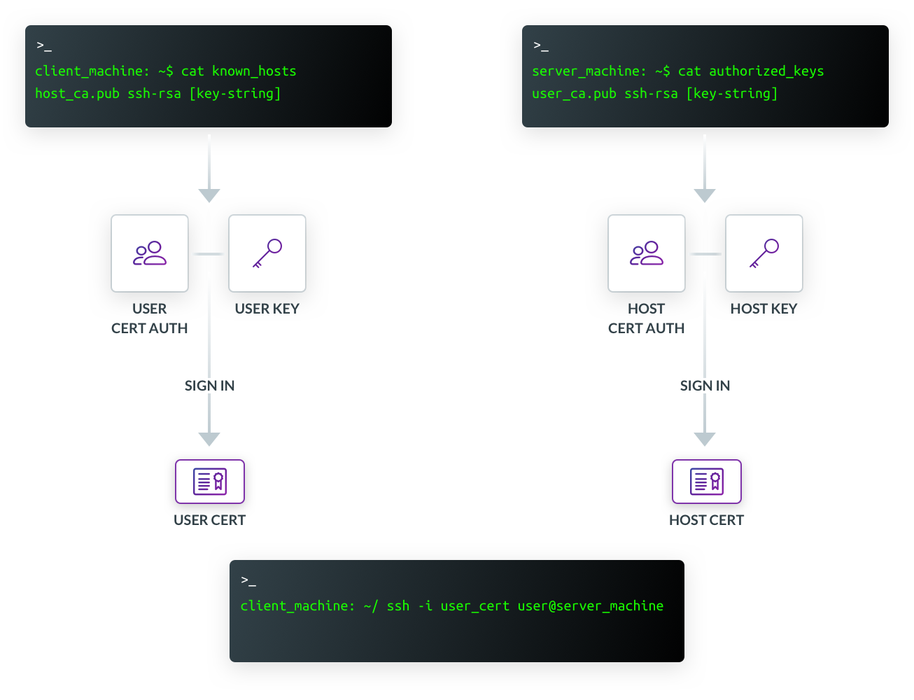
Notes:
Certs are another way to connect to a remote shell
Certs have multiple properties: (1) Identity, (2) Principles, (3) Permissions, (4) Expiry
Relies on a CA that, once configured, does not need to be touched
Clients and hosts can authenticate by knowing the CA’s public key, no laundry list of SSH keys
Process:
Request certificate from CA
CA approves and signs key to issue cert
Present cert to server
Client authenticates server, server authenticates client

Slide 9
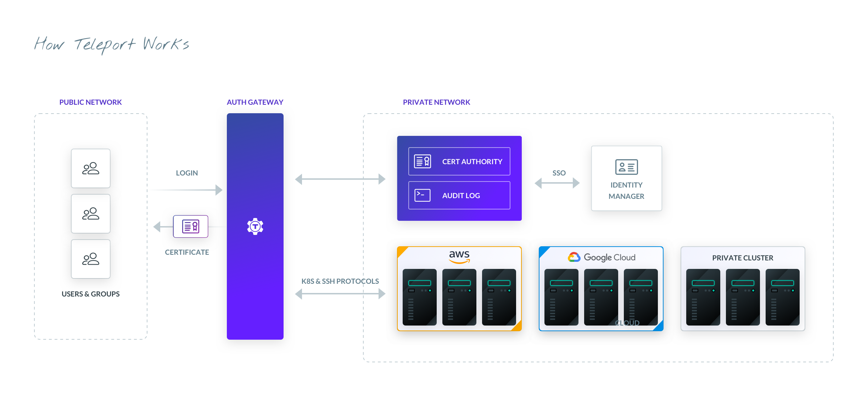

Slide 10
THANK YOU!
Meet me in the Network Chat Lounge for questions

