Slide 1


Shannon Lietz
@devsecops

Slide 2
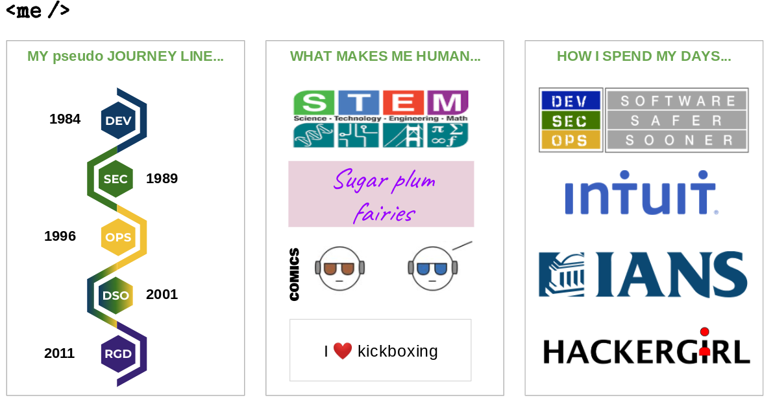
PLEASE DO NOT COVER THIS BOX – YOUR VIDEO WILL BE EMBEDDED IN THIS SPACE
PLEASE ADD YOUR PRESENTATION WITHIN THIS SPACE
PLEASE LEAVE THIS SPACE FOR YOUR GRAPHIC ARTIST RECORDING
YOUR LOGO HERE

Slide 3
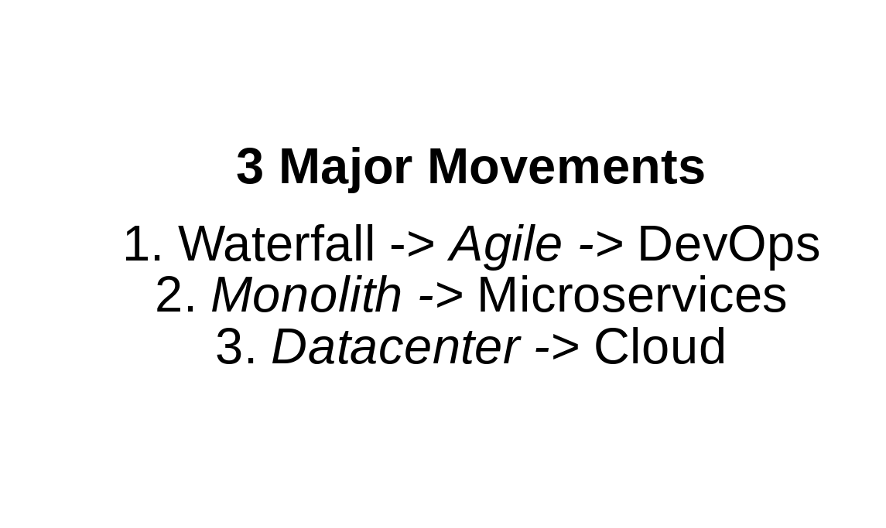
PLEASE DO NOT COVER THIS BOX – YOUR VIDEO WILL BE EMBEDDED IN THIS SPACE
PLEASE ADD YOUR PRESENTATION WITHIN THIS SPACE
PLEASE ADD YOUR PRESENTATION WITHIN THIS SPACE
PLEASE LEAVE THIS SPACE FOR YOUR GRAPHIC ARTIST RECORDING
YOUR LOGO HERE

Slide 4
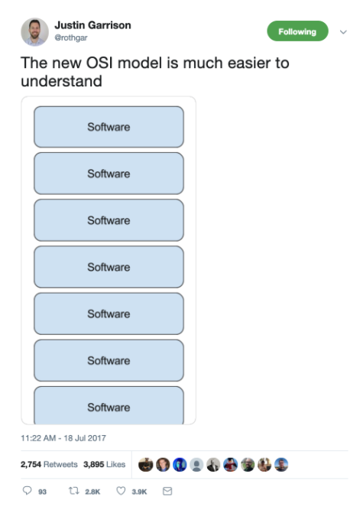
PLEASE DO NOT COVER THIS BOX – YOUR VIDEO WILL BE EMBEDDED IN THIS SPACE
PLEASE ADD YOUR PRESENTATION WITHIN THIS SPACE
PLEASE LEAVE THIS SPACE FOR YOUR GRAPHIC ARTIST RECORDING
YOUR LOGO HERE

Slide 5

PLEASE DO NOT COVER THIS BOX – YOUR VIDEO WILL BE EMBEDDED IN THIS SPACE
PLEASE ADD YOUR PRESENTATION WITHIN THIS SPACE
PLEASE ADD YOUR PRESENTATION WITHIN THIS SPACE
PLEASE LEAVE THIS SPACE FOR YOUR GRAPHIC ARTIST RECORDING
YOUR LOGO HERE

Slide 6

PLEASE DO NOT COVER THIS BOX – YOUR VIDEO WILL BE EMBEDDED IN THIS SPACE
PLEASE ADD YOUR PRESENTATION WITHIN THIS SPACE
PLEASE ADD YOUR PRESENTATION WITHIN THIS SPACE
PLEASE LEAVE THIS SPACE FOR YOUR GRAPHIC ARTIST RECORDING
YOUR LOGO HERE

Slide 7
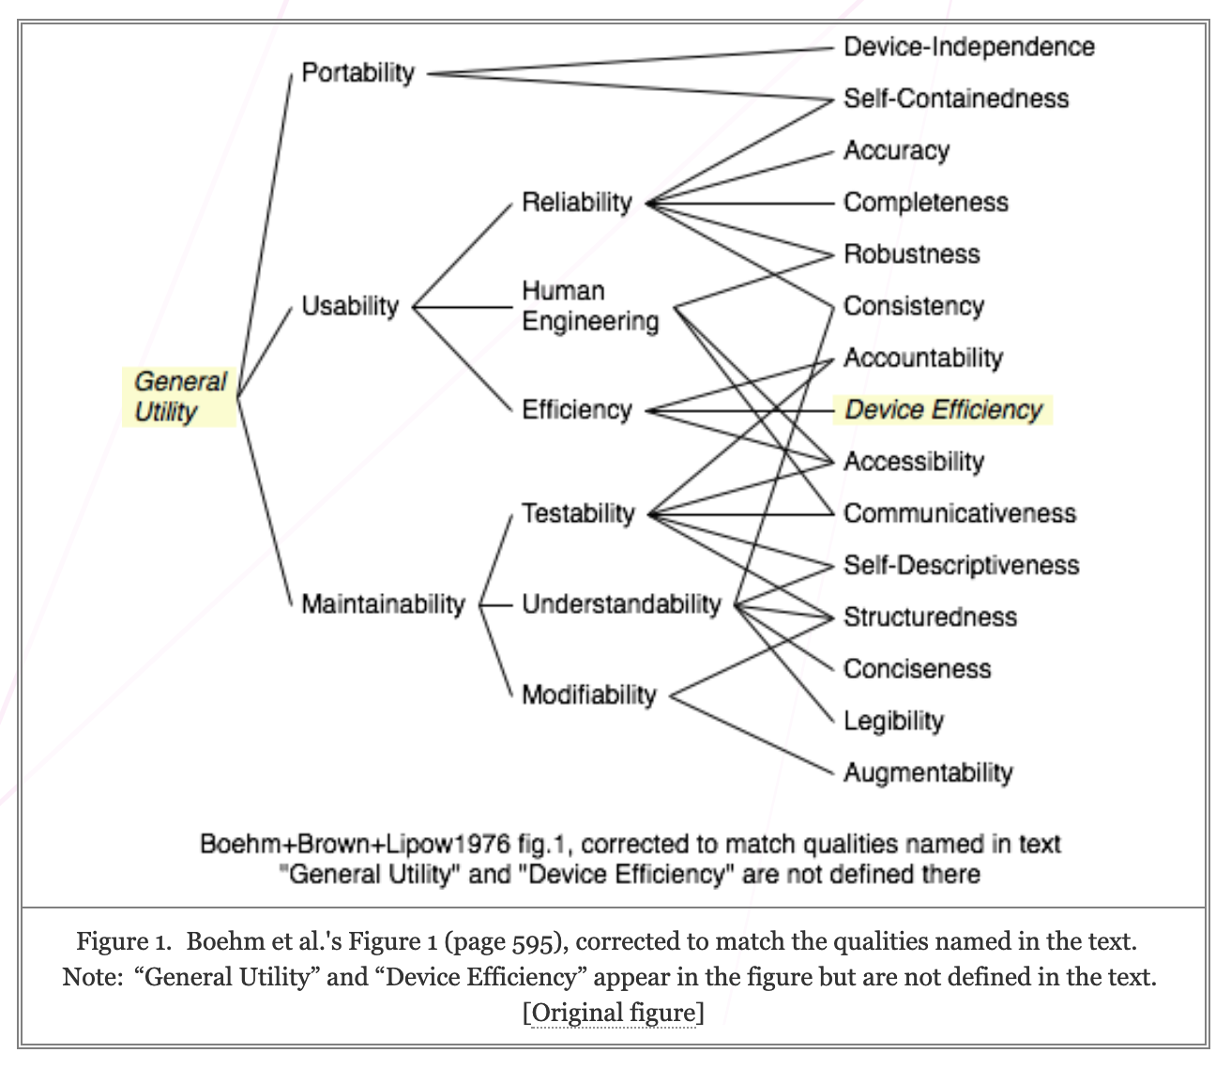
PLEASE ADD YOUR PRESENTATION WITHIN THIS SPACE
PLEASE LEAVE THIS SPACE FOR YOUR GRAPHIC ARTIST RECORDING
YOUR LOGO HERE

Slide 8
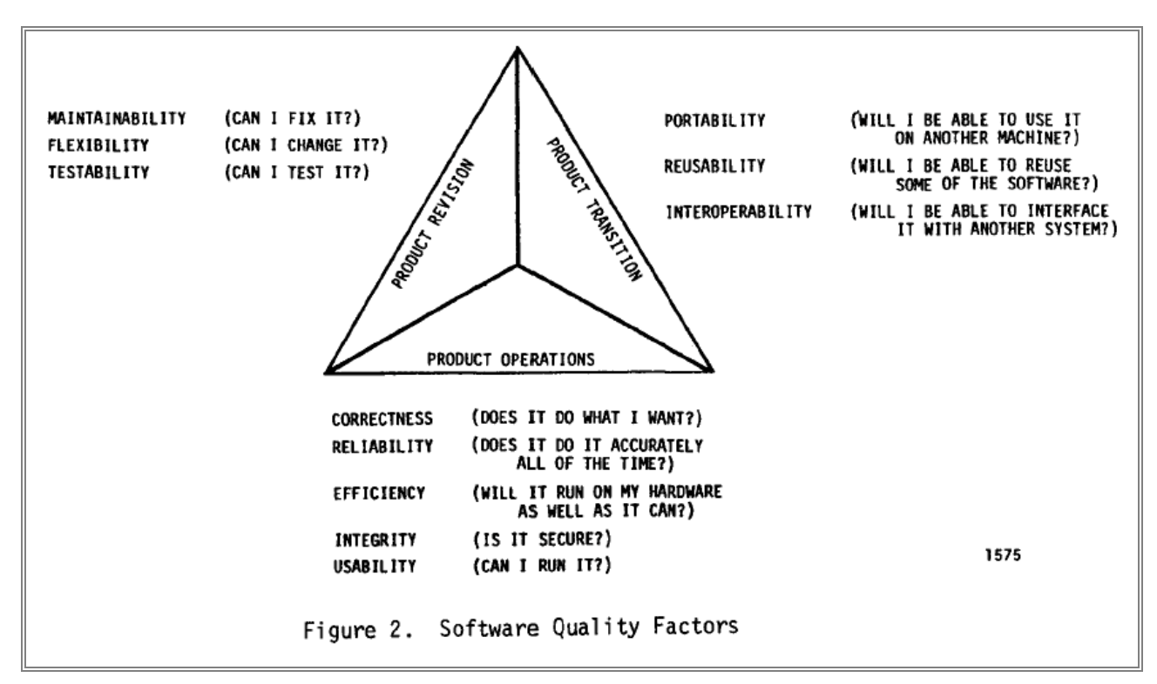
PLEASE DO NOT COVER THIS BOX – YOUR VIDEO WILL BE EMBEDDED IN THIS SPACE
PLEASE ADD YOUR PRESENTATION WITHIN THIS SPACE
Cavano and McCall's 11 Quality Factors (1978)
PLEASE LEAVE THIS SPACE FOR YOUR GRAPHIC ARTIST RECORDING
YOUR LOGO HERE

Slide 9
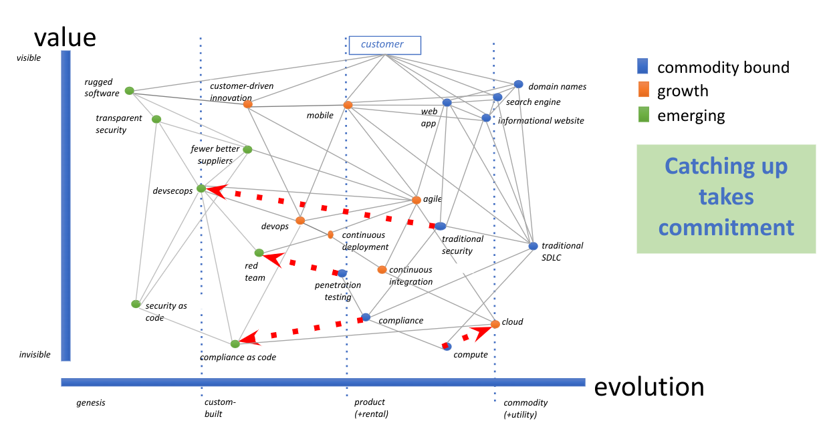
PLEASE DO NOT COVER THIS BOX – YOUR VIDEO WILL BE EMBEDDED IN THIS SPACE
PLEASE ADD YOUR PRESENTATION WITHIN THIS SPACE
PLEASE LEAVE THIS SPACE FOR YOUR GRAPHIC ARTIST RECORDING
YOUR LOGO HERE

Slide 10
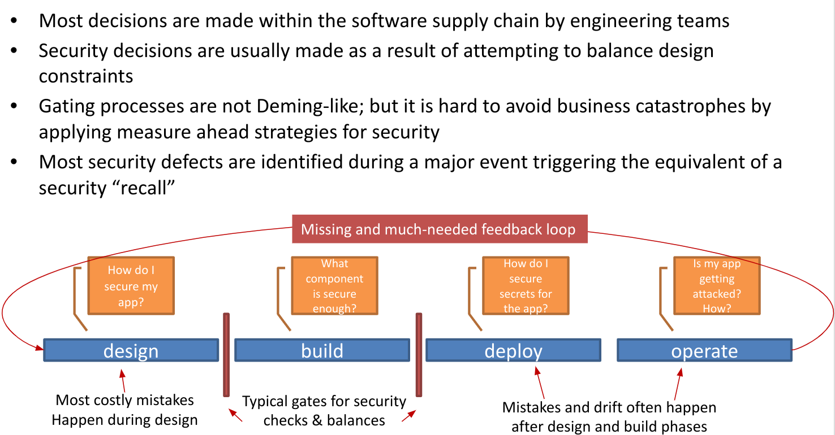
PLEASE DO NOT COVER THIS BOX – YOUR VIDEO WILL BE EMBEDDED IN THIS SPACE
PLEASE ADD YOUR PRESENTATION WITHIN THIS SPACE
PLEASE LEAVE THIS SPACE FOR YOUR GRAPHIC ARTIST RECORDING
YOUR LOGO HERE

Slide 11
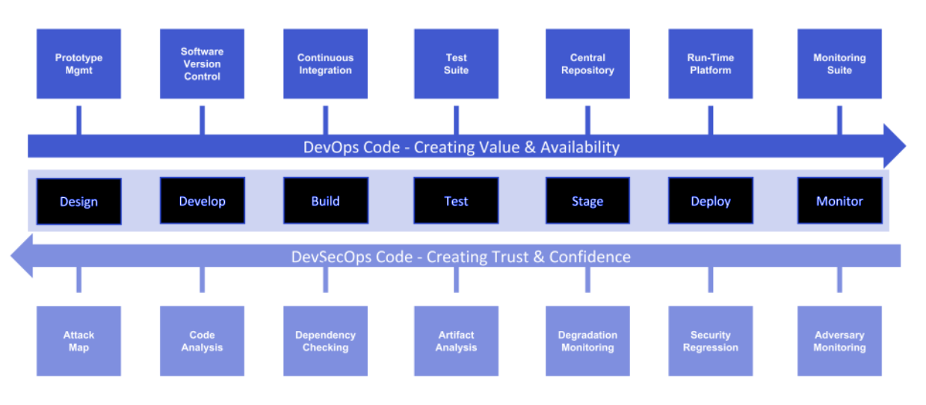
PLEASE DO NOT COVER THIS BOX – YOUR VIDEO WILL BE EMBEDDED IN THIS SPACE
PLEASE ADD YOUR PRESENTATION WITHIN THIS SPACE
PLEASE LEAVE THIS SPACE FOR YOUR GRAPHIC ARTIST RECORDING
YOUR LOGO HERE

Slide 12
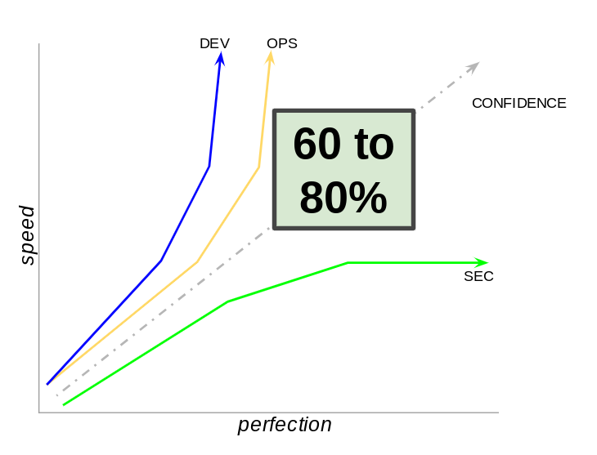
PLEASE DO NOT COVER THIS BOX – YOUR VIDEO WILL BE EMBEDDED IN THIS SPACE
PLEASE LEAVE THIS SPACE FOR YOUR GRAPHIC ARTIST RECORDING
YOUR LOGO HERE

Slide 13

PLEASE DO NOT COVER THIS BOX – YOUR VIDEO WILL BE EMBEDDED IN THIS SPACE
PLEASE LEAVE THIS SPACE FOR YOUR GRAPHIC ARTIST RECORDING
YOUR LOGO HERE

Slide 14
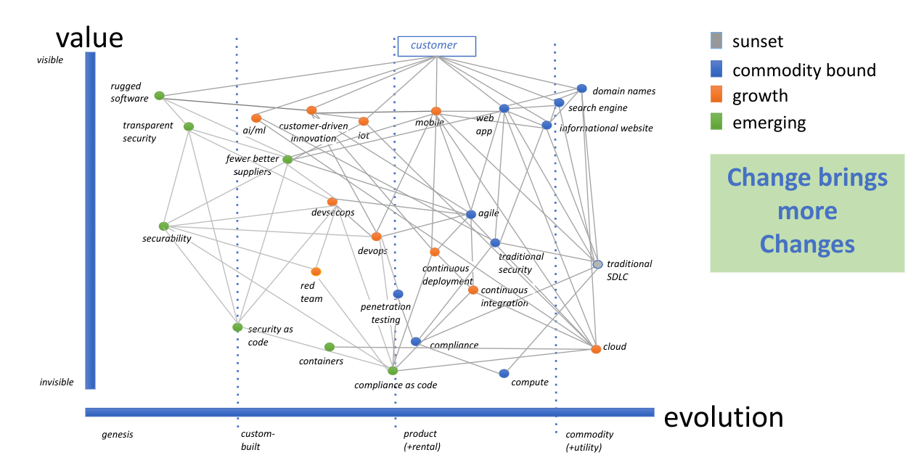
PLEASE DO NOT COVER THIS BOX – YOUR VIDEO WILL BE EMBEDDED IN THIS SPACE
PLEASE LEAVE THIS SPACE FOR YOUR GRAPHIC ARTIST RECORDING
YOUR LOGO HERE

Slide 15
PLEASE DO NOT COVER THIS BOX – YOUR VIDEO WILL BE EMBEDDED IN THIS SPACE
How do you measure security?
PLEASE LEAVE THIS SPACE FOR YOUR GRAPHIC ARTIST RECORDING
YOUR LOGO HERE

Slide 16
THANK YOU!
Meet me in the Network Chat Lounge for questions

