Slide 1


Savinder Puri
DevOps Evangelist,
Zensar Technologies, UK
@savinderpuri
savinderpuri@gmail.com

Slide 2


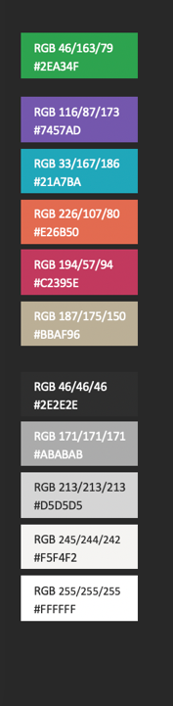
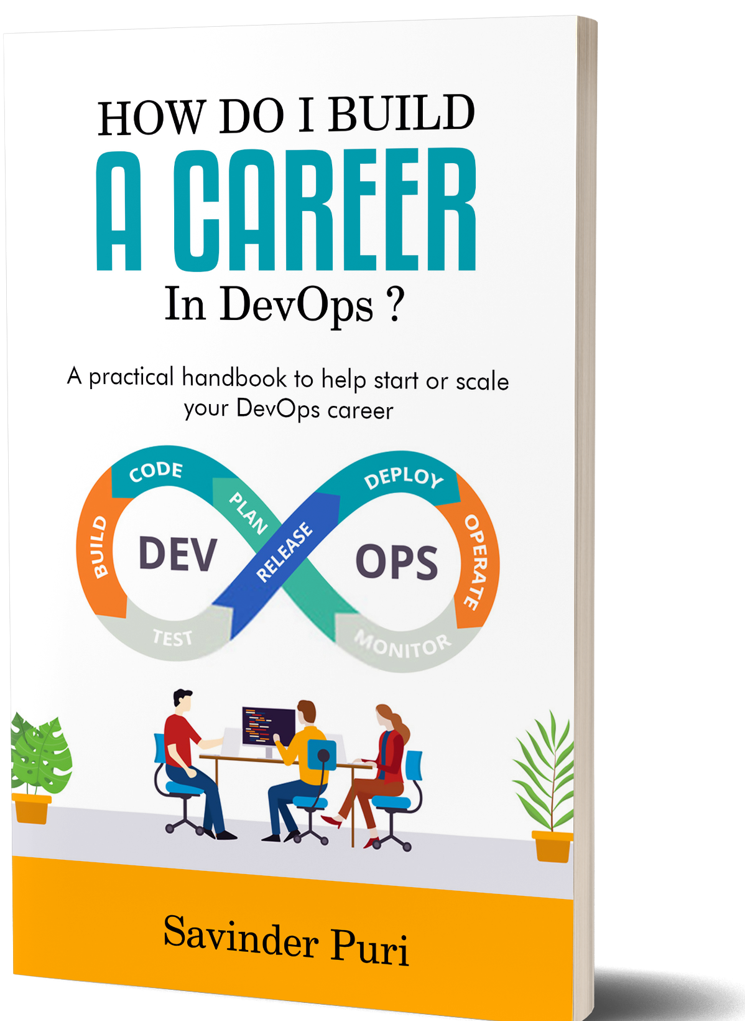

Engineering (Computers),
Class of 2000
Ambassador at DevOps Institute
& CDF
Savinder Puri
DevOps Evangelist,
Zensar Technologies, UK
Published author
(Available on Amazon worldwide)
Reiki Grandmaster &
Angelic Healer
YOUR LOGO HERE

Slide 3



Slide 4

https://amzn.to/3gu5tu0

Slide 5


Slide 6
DevOps LOVES ‘Sec’.
It adds the glitter to DevSecOps!
Everyone knows that Security
isn’t a real tool/process, it’s a mindset

Slide 7


Slide 8
Everywhere that you go,
add a bit of ‘sec’!
That’s how you make the security mindset actionable

Slide 10
Glitter the entire SDLC!!!
PO, UX, Dev, Testers, Ops, Network...
everyone has a part to play!
Notes:
Security is not the responsibility of some team sitting in a corner. It’s everyone’s responsibility.
It’s the Product Owners responsibility to ensure Security is given it’s due weightage
It’s the developer’s responsibility to ensure he/she does not include a corrupt library in the code
It’s the testers responsibility to catch that security vulnerability
It’s the Operations responsibility to not run that web server as root!
Security is a mindset in everything you do, whatever your role is!
Even the janitor has to ensure they do not leave the keys lying around ☺

Slide 11
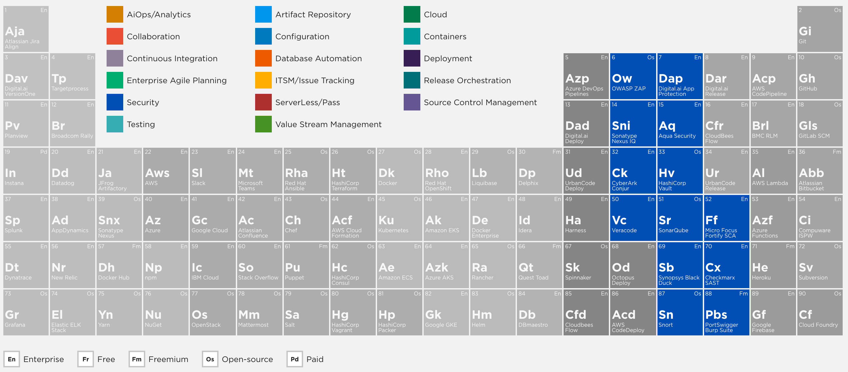
https://digital.ai/periodic-table-of-devops-tools

Slide 12
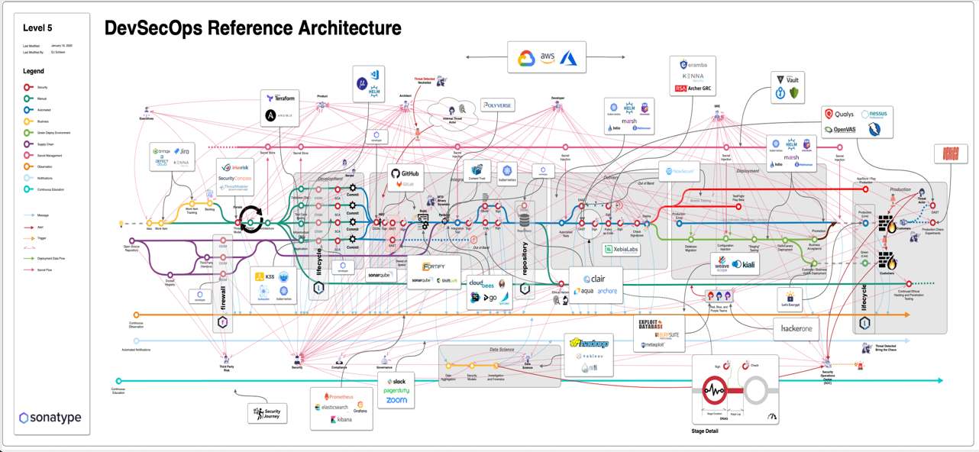
https://www.sonatype.com/referencearchitecturetestdrive

Slide 13


Slide 14
Why can’t we get our actors together?
“loss of control”

Slide 15
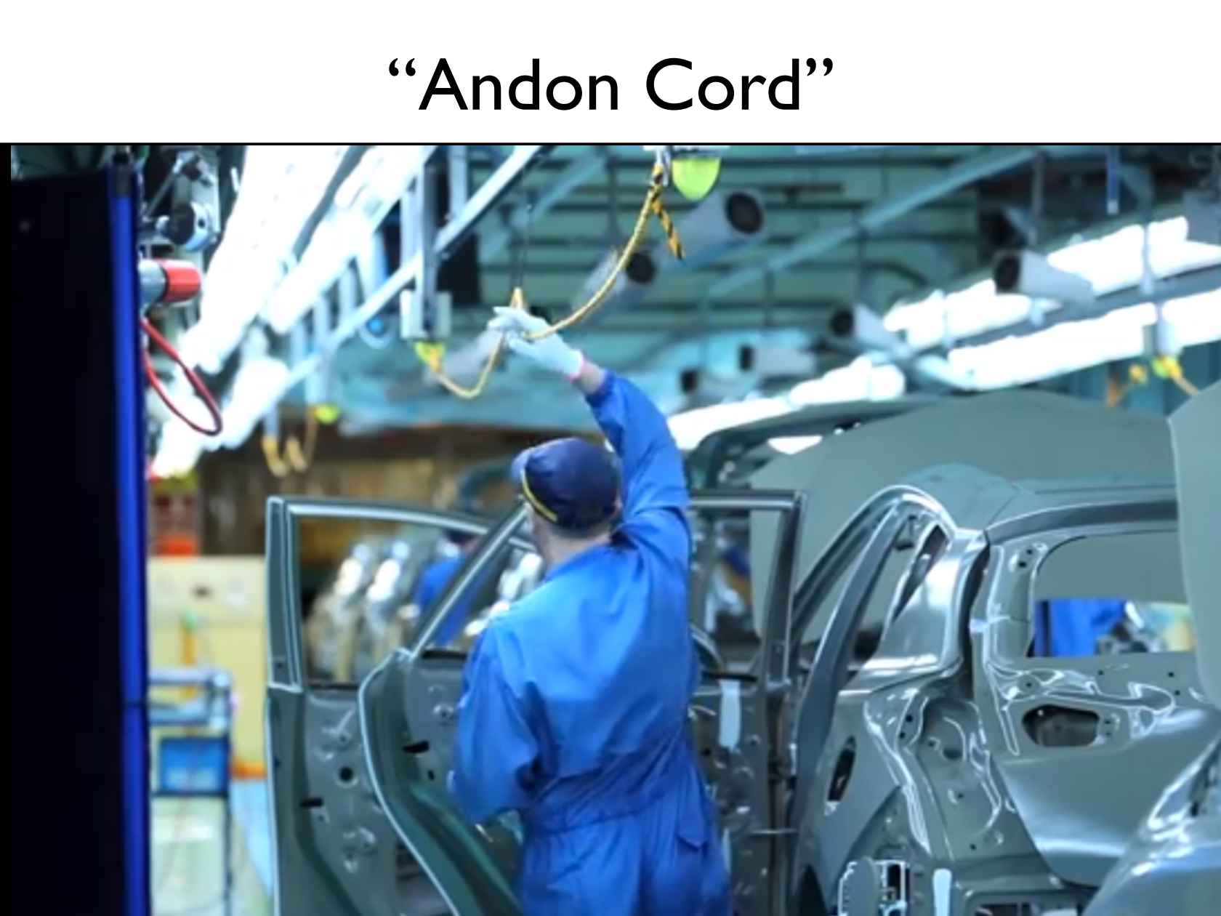
DevSecOps will give you the “Andon Cord”!

Slide 16
CI/CD Pipelines
+ Alerts (thresholds)
+ Discipline
-------------------------------
= Andon Cord
-------------------------------
https://medium.com/@jjruescas/to-improve-pull-the-cord-ec309fa9d701

Slide 17

Jenkins CI/CD pipeline
https://medium.com/@jjruescas/to-improve-pull-the-cord-ec309fa9d701

Slide 18
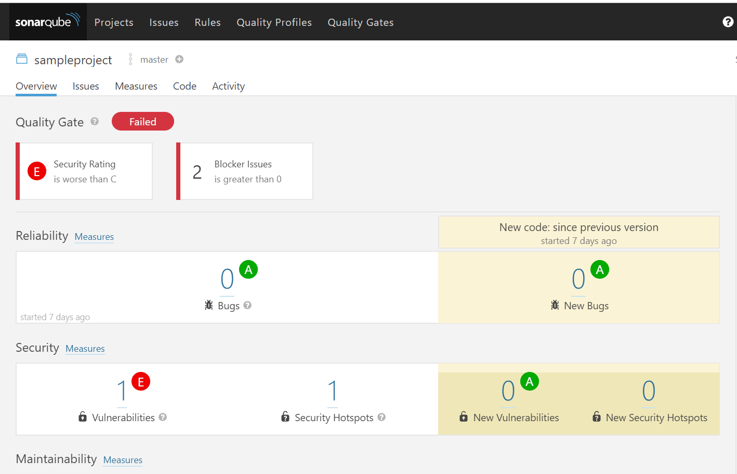

Slide 19

Beware of the “SonarQube Circle!”

Slide 21
Follow the iterative approach here...
Nothing succeeds like success!

Slide 22


Slide 23
With “Compliance-as-code (CaC)”, ‘
sec’ will go everywhere!
That’s how you make the security mindset actionable

Slide 24
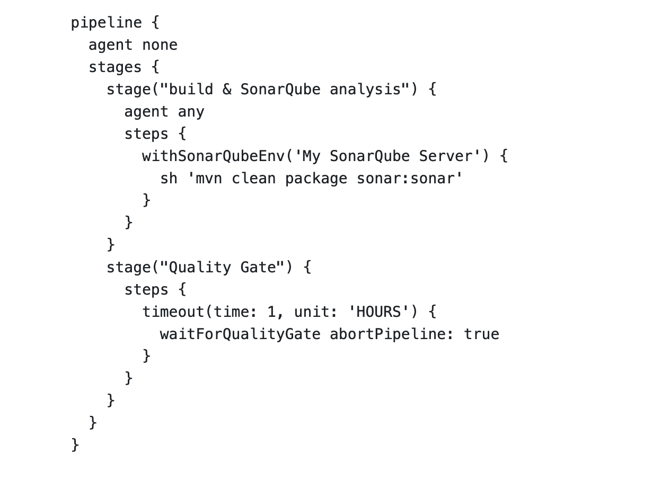
Jenkins Pipeline for
SonarQube Quality Gate
https://www.jenkins.io/doc/pipeline/steps/sonar/

Slide 25
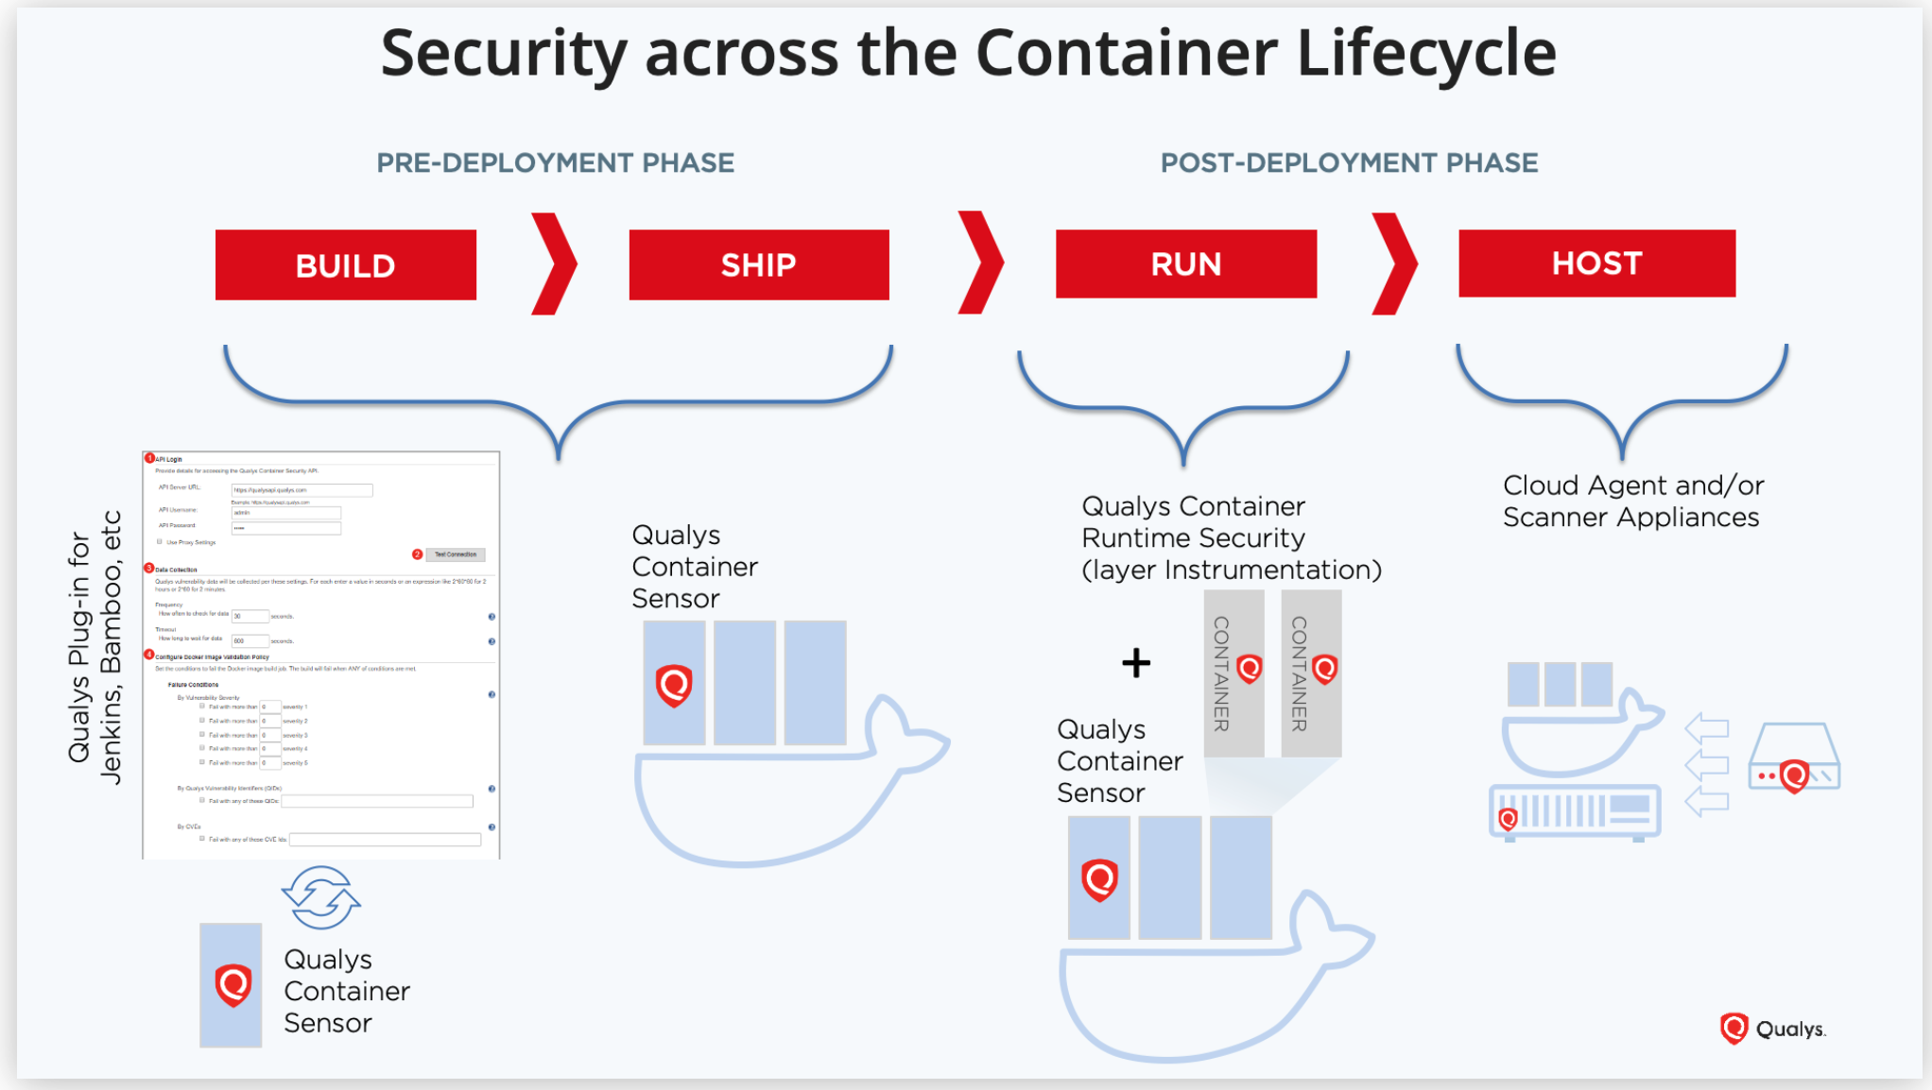
Illustrative example with Qualys (love the representation!); there are several other toolset options out there
https://bit.ly/34Ohadd

Slide 27
Once you get ‘sec’ into the DNA,
it just organically spreads everywhere!

Slide 29
THANK YOU!
Meet me in the Network Chat Lounge for questions

