Slide 1


Martyn Coupland
Senior Technical Consultant
Ensono
@mrcoups
martyn@devopsdevops.com

Slide 2



Slide 3


Slide 4
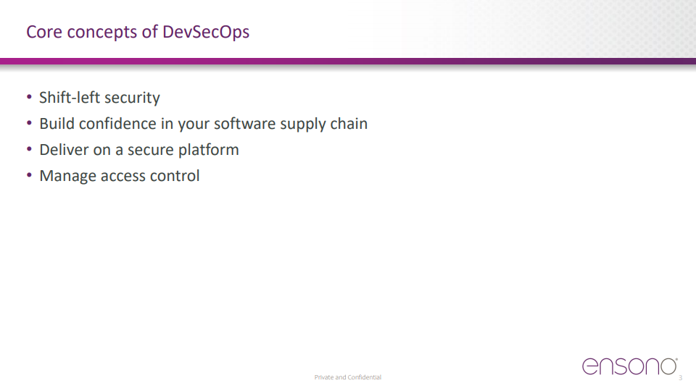

Slide 5
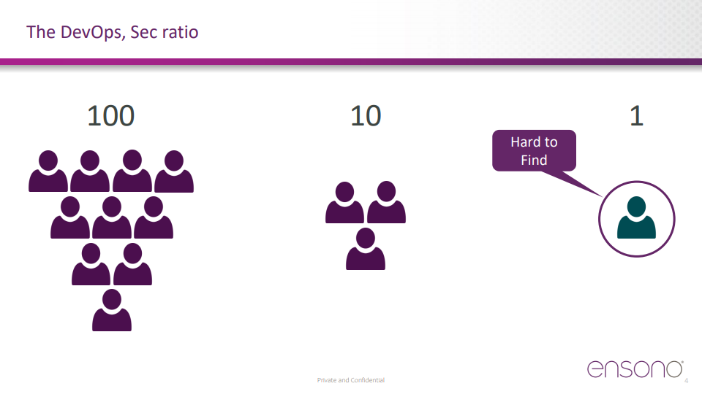

Slide 6
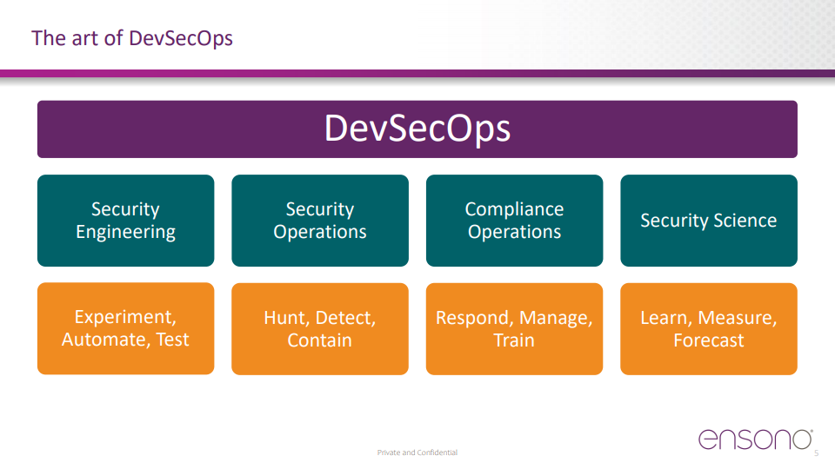

Slide 7
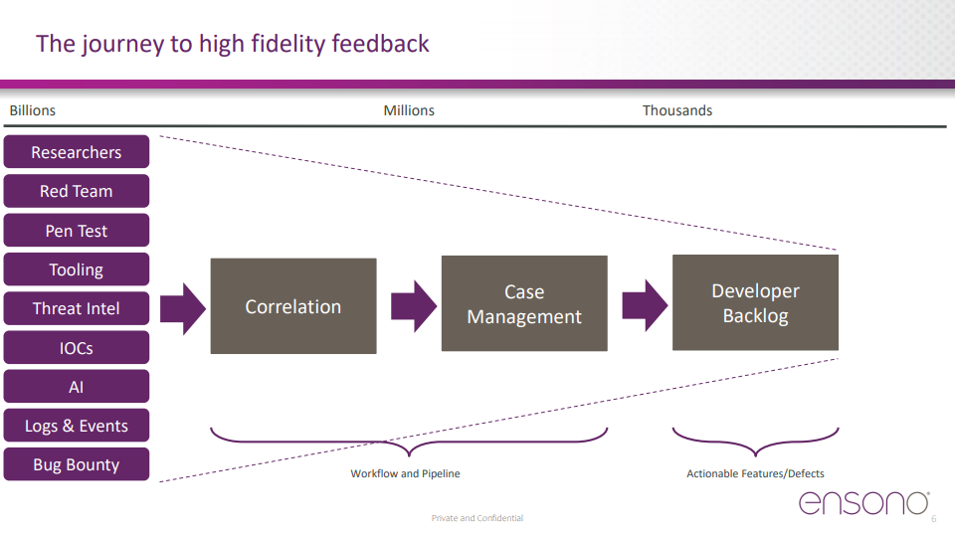

Slide 8


Slide 9
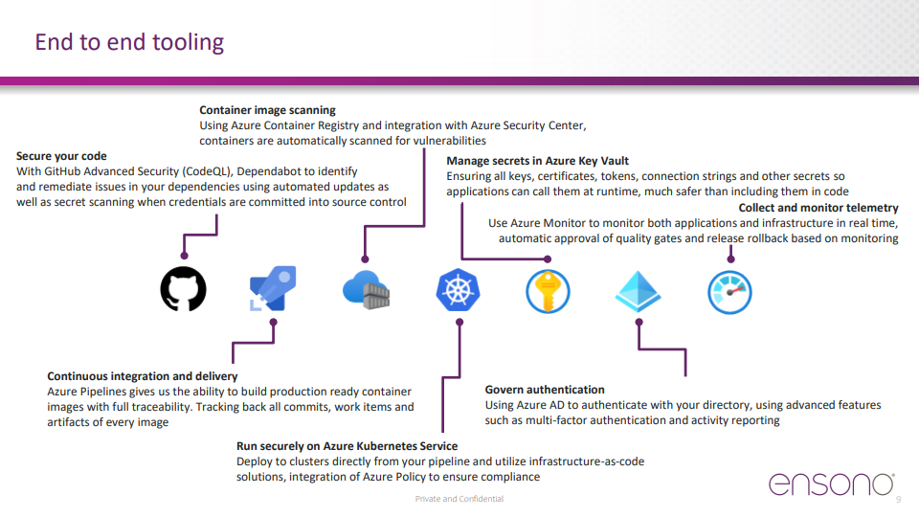

Slide 10
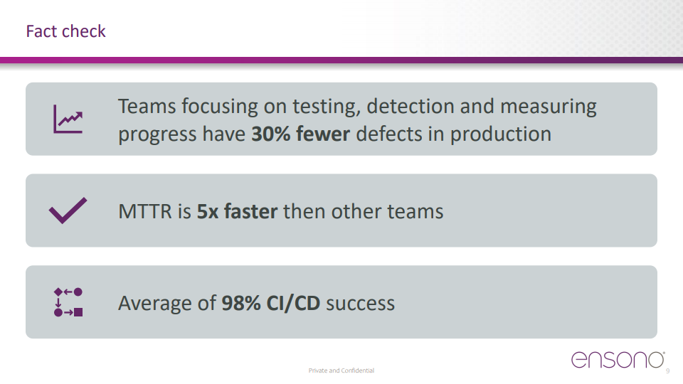

Slide 11
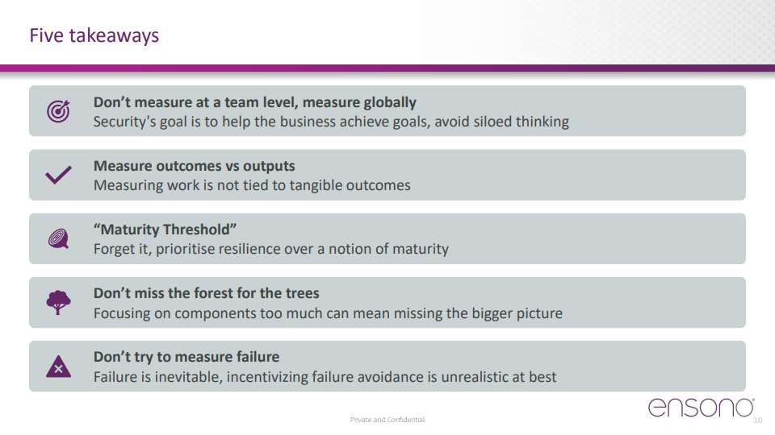

Slide 12


Slide 13
THANK YOU!
Meet me in the Network Chat Lounge for questions

