Slide 1
All About Ops
Dr. Mark Peters, DOI Ambassador
Technica Corporation

Slide 2
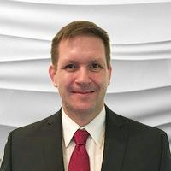

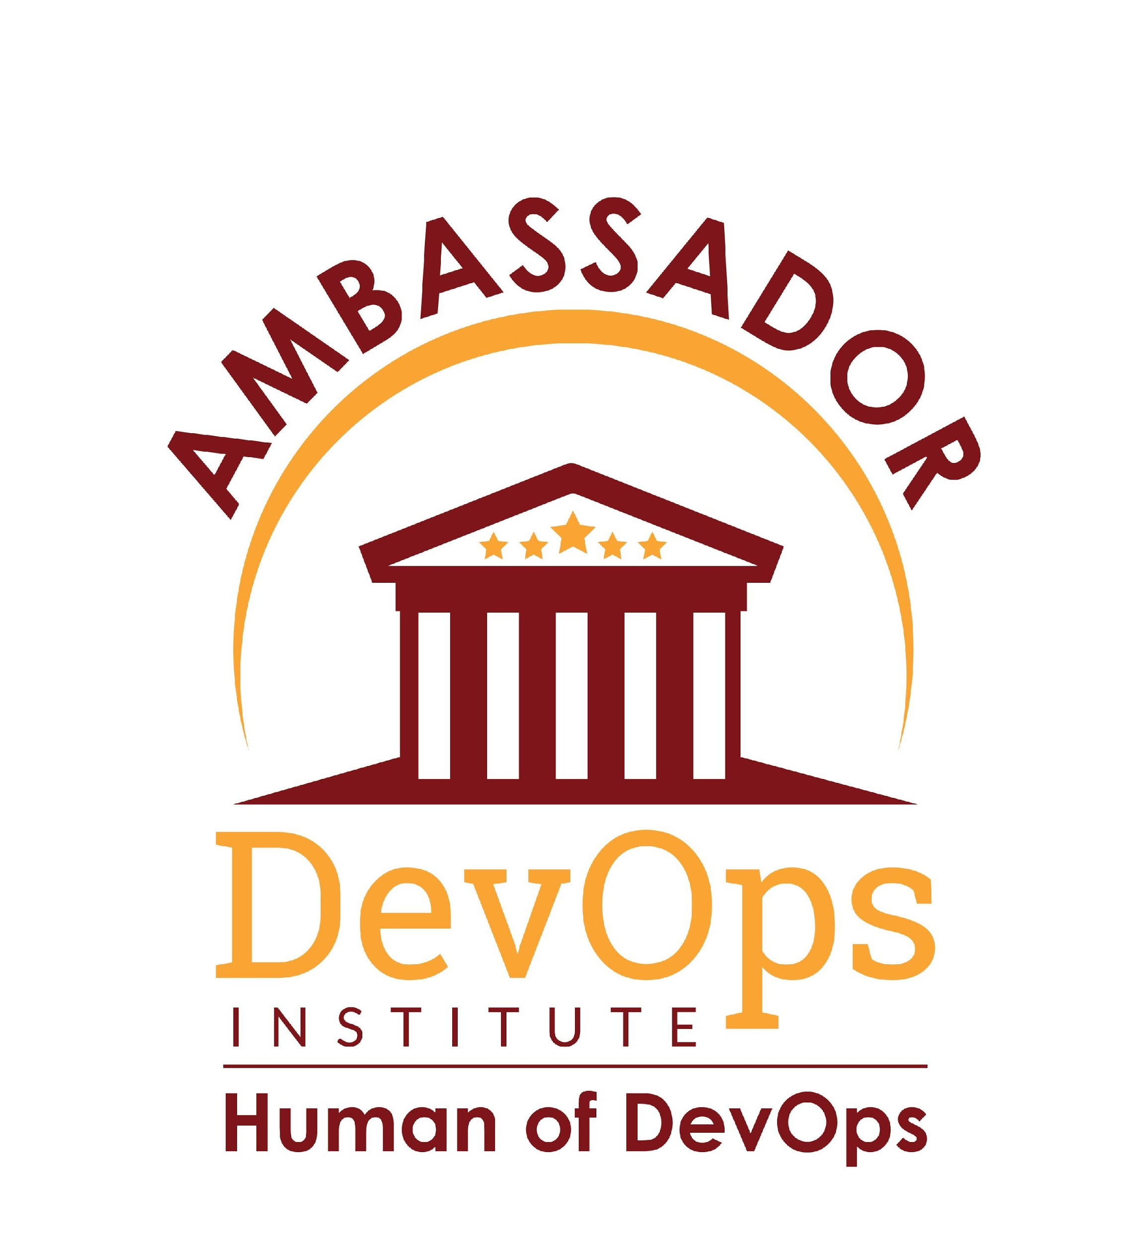
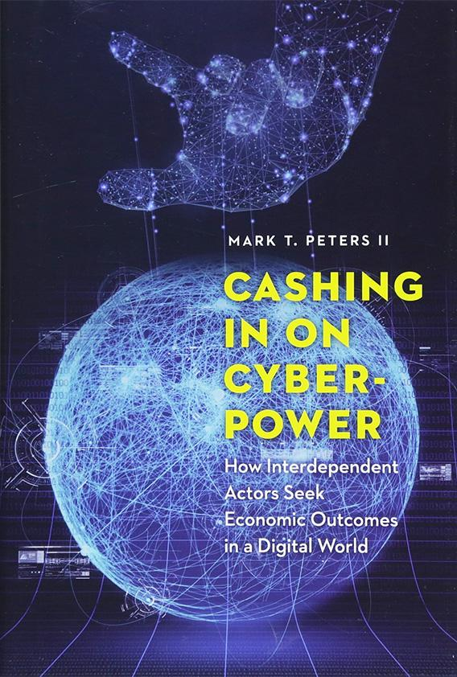
Who is Dr. Mark Peters?
US Air Force Intelligence
Retired after 22 years
Experienced with multi-level compliance
Cybersecurity
Built programs at multiple USAF units
Worked w/two transitioning DOD cyber weapons systems to DevOps
Other
Dr of Strategic Security
DevOps Institute Ambassador
Avid reader, professional Reviewer
Writer (Cashing in on Cyberpower)

Slide 3
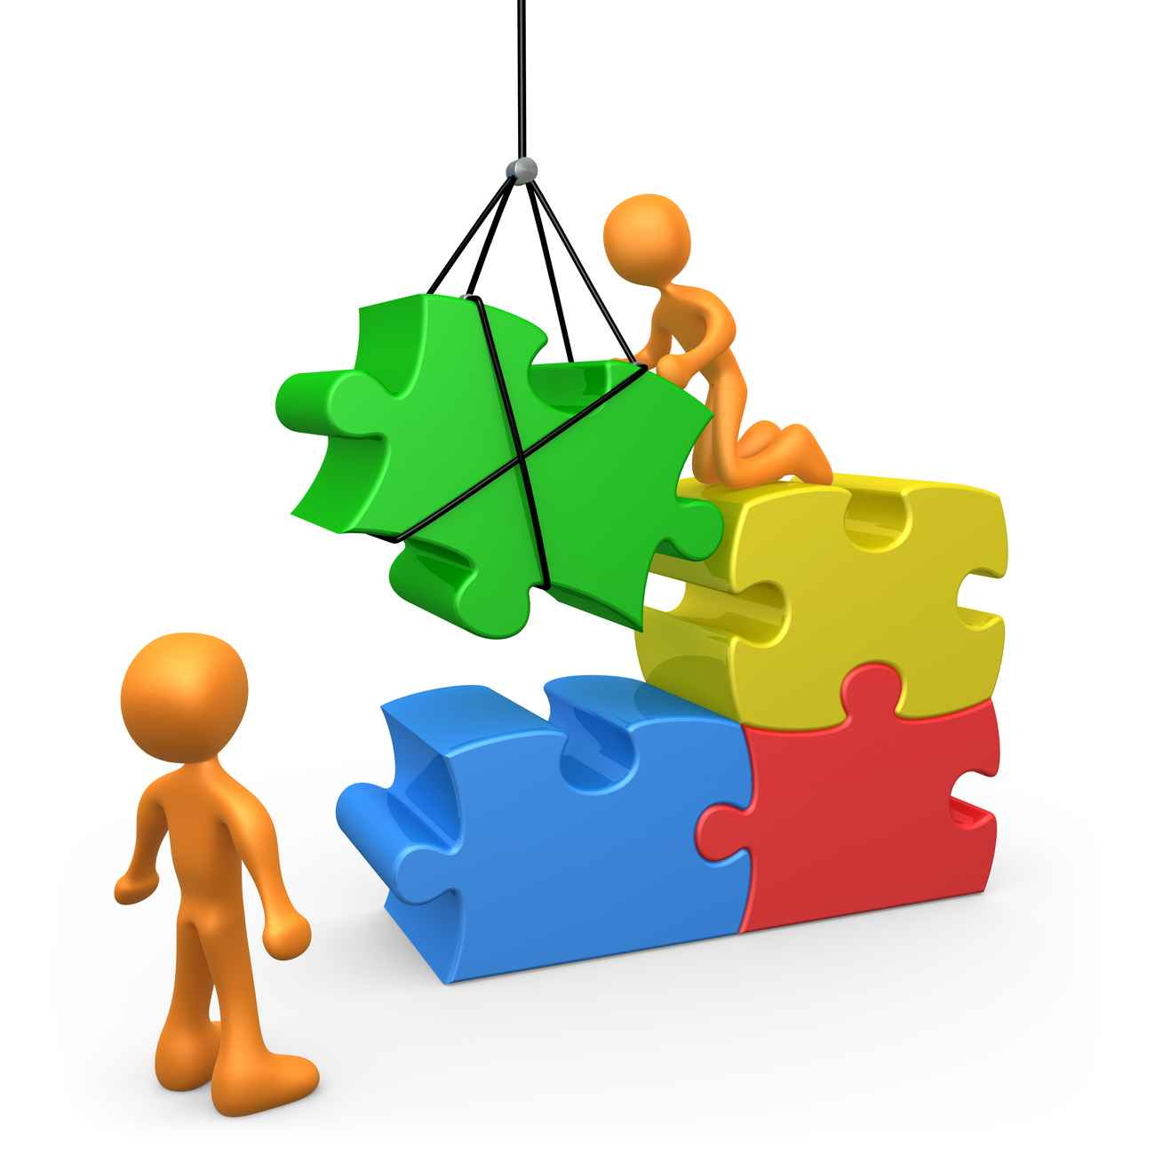
Ops Drives Value
Modern Technology profitability – means ops
  Ops interacts with customers and creates cashflow
  Dev adds new features but lacks customer focus
  Sec creates compliance but needs code
Why bother with DevSecOps or DevOps?
Your business is ALL ABOUT OPS!
Notes:
Modern technology and profitability rely primarily on Ops so despite advocating DevSecOps practices, all sensible individual realize successful businesses are all about Ops. Upset yet? Understanding how to balance Dev, Sec, and Ops for your organization should matter to all professionals and this article emphasizes balance from ops. Development (Dev) creates competitiveness but without ops nothing reaches customer. Security (Sec) manages compliance but without ops and dev, no products exist to become secure or compliant.

Slide 4
Mad yet?
DevSecOps is a complex ecosphere about managing dependency
Equality between tasks creates flow and feedback
Ops
Sec
Dev
Value
Are your workflows balanced?

Slide 5

Does this feel like your Org chart after a DevSecOps transformation?

Slide 6
Mapping Interaction
Personal Preference
Simple: 2 Apples + 2 Apples?
  4 Apples
Complicated: Buying 2 more apples
  $ 2 less in my pocket, 2 apples less in store inventory
Complex: Gordian Knot
  Every issue tied to every other issue
Functional Interaction
Corporate Guardrails
Where do you interact?

Slide 7

More basics
Interactions may be dependent or independent
  Dependency – heating a pot of water raises the temperature
  Independent – heating water never changes refrigerator temp
DevSecOps practices are interdependent
  Resilient with complex interactions
  Non-linear, less predictable outcomes
  Each element linked to outcomes
People over processes

Slide 8
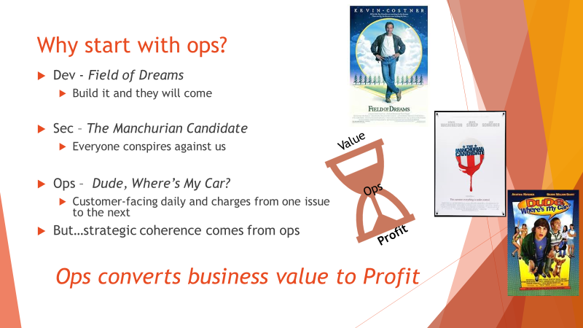


Why start with ops?
Dev usually Field of Dreams
  Build it and they will come
Sec needs DevOps interaction
  Locking down before integration? Bad practice
Ops converts business value into profit
  Customer-facing daily
  Strategic coherence comes from ops
Value
Ops
Profit

Slide 9

Ops First, Not Ops Only
DevSecOps is about balance
  Flow, Feedback, Learning
  Empower Ops to improve
Value question is not, “How do I build?”
  How does the team consistently produce and deliver secure capabilities to enhance value?
Dev - New value, Sec – Increases value, Ops – Converts Value

Slide 10



Balanced Yet?

Slide 11
Find the right balance
Dev
Ops
Sec
Personal and Professional relationships
Ops – maximize revenue, function securely, create ideas
Dev – improve existing, plan new, deploy often
Sec – secure deployments, minimize risk, suggest opportunity
Value
Metrics can show balance

Slide 12

DevOps Institute Can Help
New DevSecOps Foundations course, 1 or 2 days, Taught by Pros
Walks through processes
  What does Security mean to you?
  Where do your organization’s values create balance?
  Setting up your own DevSecOps Program
  with best practices, pipelines, and metrics
Later this year- Improved advanced courses
Find Balance, Get Certified

Slide 13
Not just about Ops
Lose the emotions, find balance in practices
Shortfalls drive action
  Action creates imbalance
    Lack of balance requires new action
Simple Metrics
  Find the base rates
    Start where you are
Balance is the Journey, Not the End

Slide 14
All About Ops
Dr. Mark Peters, DOI Ambassador
@TinyCyber
linkedin.com/in/markpeters5447/

