Slide 1
GitOps: Declarative, Automated Production
Michele Mancioppi
Technical Product Manager
Instana
@mmanciop

Slide 2

Agenda
Headshot
What is GitOps
Why GitOps
How to GitOps
What GitOps is not
Gotchas
Michele Mancioppi
Technical Product Manager
@mmanciop
Michele Mancioppi serves as Product Manager for agent, distributed tracing, Cloud Foundry and VMware Tanzu. Michele holds a Bachelors and Masters degree in Computer science from Università di Trento and a PhD in Information Systems from Tilburg University, the Netherlands.
Notes:
“Hi my name is Michele Mancioppi. I am a technical product manager at Instana.”
“In the ‘GitOps: Declarative, Automated Production’ talk, we are going to cover a lot of different aspects with GitOps. What it is, what it is not, why should you consider doing it.”
“This talk is aimed at people not familiar with GitOps, but that are curious to know what it is about. And it may also be interesting for practitioners that are adopting GitOps, as it will provide, some reality checks of does, dont’s and must haves.”
“What we will not do in this talk is to go in details in any one particular setup or set of tools.”
“As a disclaimer, I have no delusions of being an expert of GitOps or having given contributions to the state of the art; with the exception, maybe, of one thing that we will briefly touch upon. So, besides drawing from my personal experience and those of my colleagues at Instana, I put together this talk based on publicly available material from a number giants in the field of GitOps and DevOps, who are openly credited whenever applicable.”

Slide 3
What is GitOps

Slide 4
GitOps from a 1000 miles
Dev(Sec)Ops operational model
Declarative Infrastructure
Merge Requests
Continuous Integration / Continuous Delivery
GitOps
Diagram inspired by GitLab’s “What is GitOps?”
Notes:
GitOps is one way to doing DevOps or DevSecOps, and specifically one in which the security aspect dovetails really nicely.
* CLICK*
You declare your infrastructure as code, including configurations, applications and everything else, and put it in one or more repositories of a versioning system, which is almost always Git nowadays. These repositories become your SOURCE OF TRUTH, the desired state of how your production should look like.
*CLICK*
You change production by MERGING REQUESTS to your source of truth
*CLICK*
Which are then verified automatically and then put in production by CONTINUOUS INTEGRATION / CONTINUOUS DELIVERY systems

Slide 5
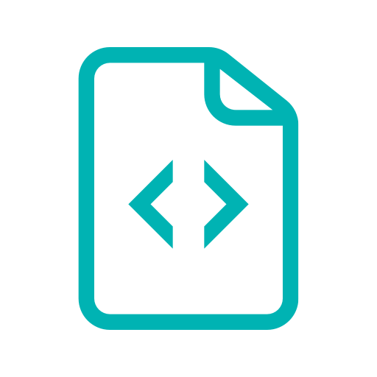


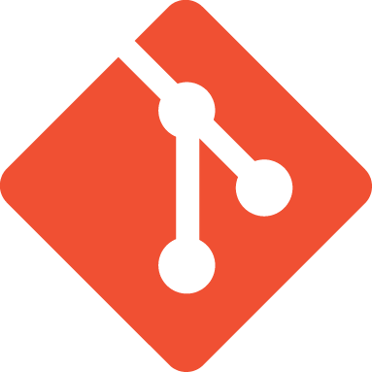



A GitOps Workflow
Commit / Merge changes to declarative specification
Source of truth
Push
or Pull
Push
or Pull
Product
Teams
Versioning System
Continuous Integration /
Continuous Delivery
Infrastructure as Code
Reconciliation
Diagram inspired by:
“Guide To GitOps”, Weaveworks
Notes:
Now, let’s get a bit more concrete. A typically GitOps workflow starts with DevOps teams
CLICK
Committing changes to the versioning system, which is the “Source of Truth”
CLICK
Then there is a CI/CD system
CLICK
Push that desired state to the Infrastructure as Code system
CLICK
that needs to continuously do Reconciliation to maintain the desired state across changes and failures.
Reconciliation is fundamental: if your Infrastructure as Code tooling can only make infrastructure to match some state, but not keep it like that in the face of inevitable failure of components, drift is inevitable.
On Kubernetes, for example, reconciliation is done by Kubernetes itself, which will create missing pods and other resources.
Disclaimer: there are people out there that, somewhat dogmatically, say that GitOps is only when you pull from operators and not when you push changes… To me, that is just an implementation detail, however interesting and geeky it may be.
Also, you may hear some variations on the concepts of CI/CD such as “Continuous Operations”. While conceptually interesting, IMO these new concepts do not add that much to the picture of GitOps, especially for people first approaching GitOps.

Slide 6
GitOps from a 1000 miles
(Revisited)
Declarative
Versioned
Automatically managed
Automatically verified
Self-service
Collaborative
Cloud-native
(but not only)
Declarative Infrastructure
Merge Requests
Continuous Integration / Continuous Delivery
GitOps
Diagram inspired by GitLab’s “What is GitOps?”
Notes:
GitOps is one way to doing DevOps or DevSecOps, and specifically one in which the security aspect dovetails really nicely.
* CLICK*
You declare your infrastructure as code, including configurations, applications and everything else, and put it in one or more repositories of a versioning system, which is almost always Git nowadays. These repositories become your SOURCE OF TRUTH, the desired state of how your production should look like.
*CLICK*
You change production by MERGING REQUESTS to your source of truth
*CLICK*
Which are then verified automatically and then put in production by CONTINUOUS INTEGRATION / CONTINUOUS DELIVERY systems

Slide 7
The Pillars of GitOps
Control over your environments via ...
Pipelines that automate:
  Continuous Deployment
  Continuous Integration
  Release Automation
Observability is fundamental:
  The more you automate…
  The faster you want to ship...
  The better observability you need
Pipelines
Observability
Control
Credit: GitOps - Operations by Pull Request [B]
Alexis Richardson, Weaveworks & William Denniss

Slide 8
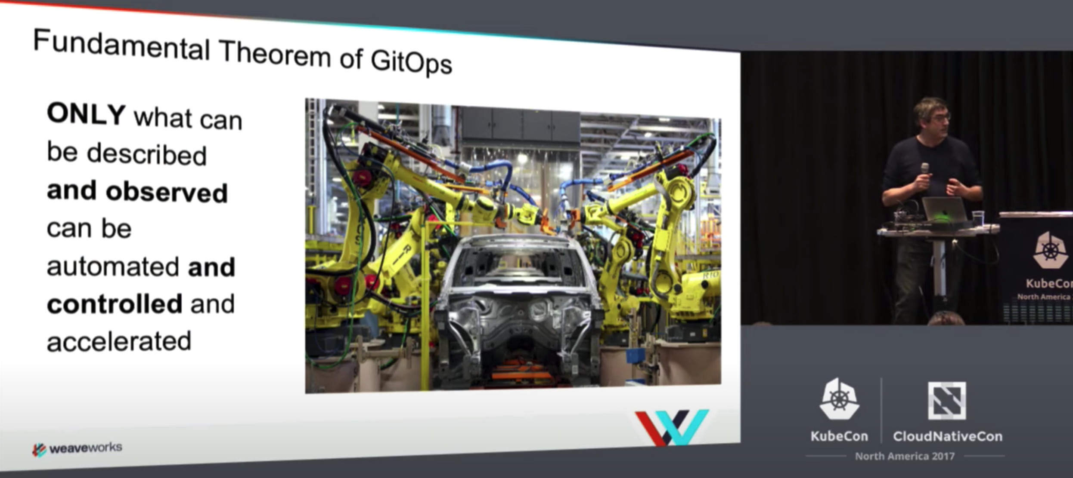
The Fundamental Theorem
Only what can be described
And observed
Can be automated
And controlled
And accelerated
Credit: GitOps - Operations by Pull Request [B]
Alexis Richardson, Weaveworks & William Denniss

Slide 9
Why GitOps
Notes:
So, GitOps sounds like a great idea, but let’s explicitly talk about what doing GitOps will bring you.

Slide 10

The Gifts of GitOps
Repeatable Deployments & Higher Reliability
Consistency and Standardization
Stronger Security Guarantees
Great Auditability
Inspired by “Guide To GitOps”, Weaveworks
Notes:
Repeatable Deployments & Higher Reliability
Since your entire system is described in Git, you also a single source of truth from which to recover after a meltdown, reducing your meantime to recovery. And the versioning means that, in case you rollout a bad change, it is easier to roll it back.
Consistency and Standardization
The one model that GitOps provides for creating the infrastructure, containers, applications and so on, gives you a consistent end-to-end workflows across your entire organization. Your operation tasks are reproducible, and that makes it easier to avoid major drifts in how your different environments look like.
Stronger Security Guarantees
Git’s strong correctness and security guarantees, especially when using signed tags, allows you to prove authorship and origin is key to a secure definition of the desired state of the cluster.
Auditabily
An audit trail of who did what, and when to your cluster can be used to meet SOC 2 and other compliance requirements and ensure stability.

Slide 11
How to GitOps

Slide 12

You must be this DevOps
to GitOps
Strong DevOps fundamentals:
  Continuous integration and deployment
  Control & Automated feedback loop
  Team empowerment
  Excellent observability
Deploy on infrastructure that you can declaratively specify
  Ubiquitous in Cloud, less so in own Datacenters
Notes:
To do GitOps, you should have
*CLICK*
Very strong DevOps skills and mentality
*CLICK*
And deploy on an infrastructure that facilitates the task

Slide 13


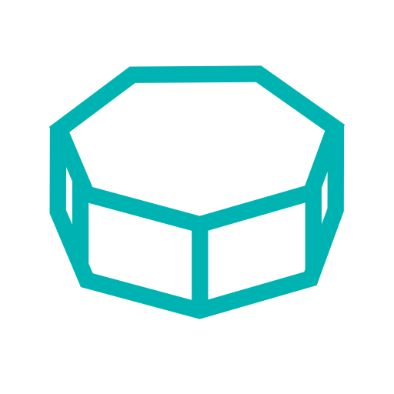

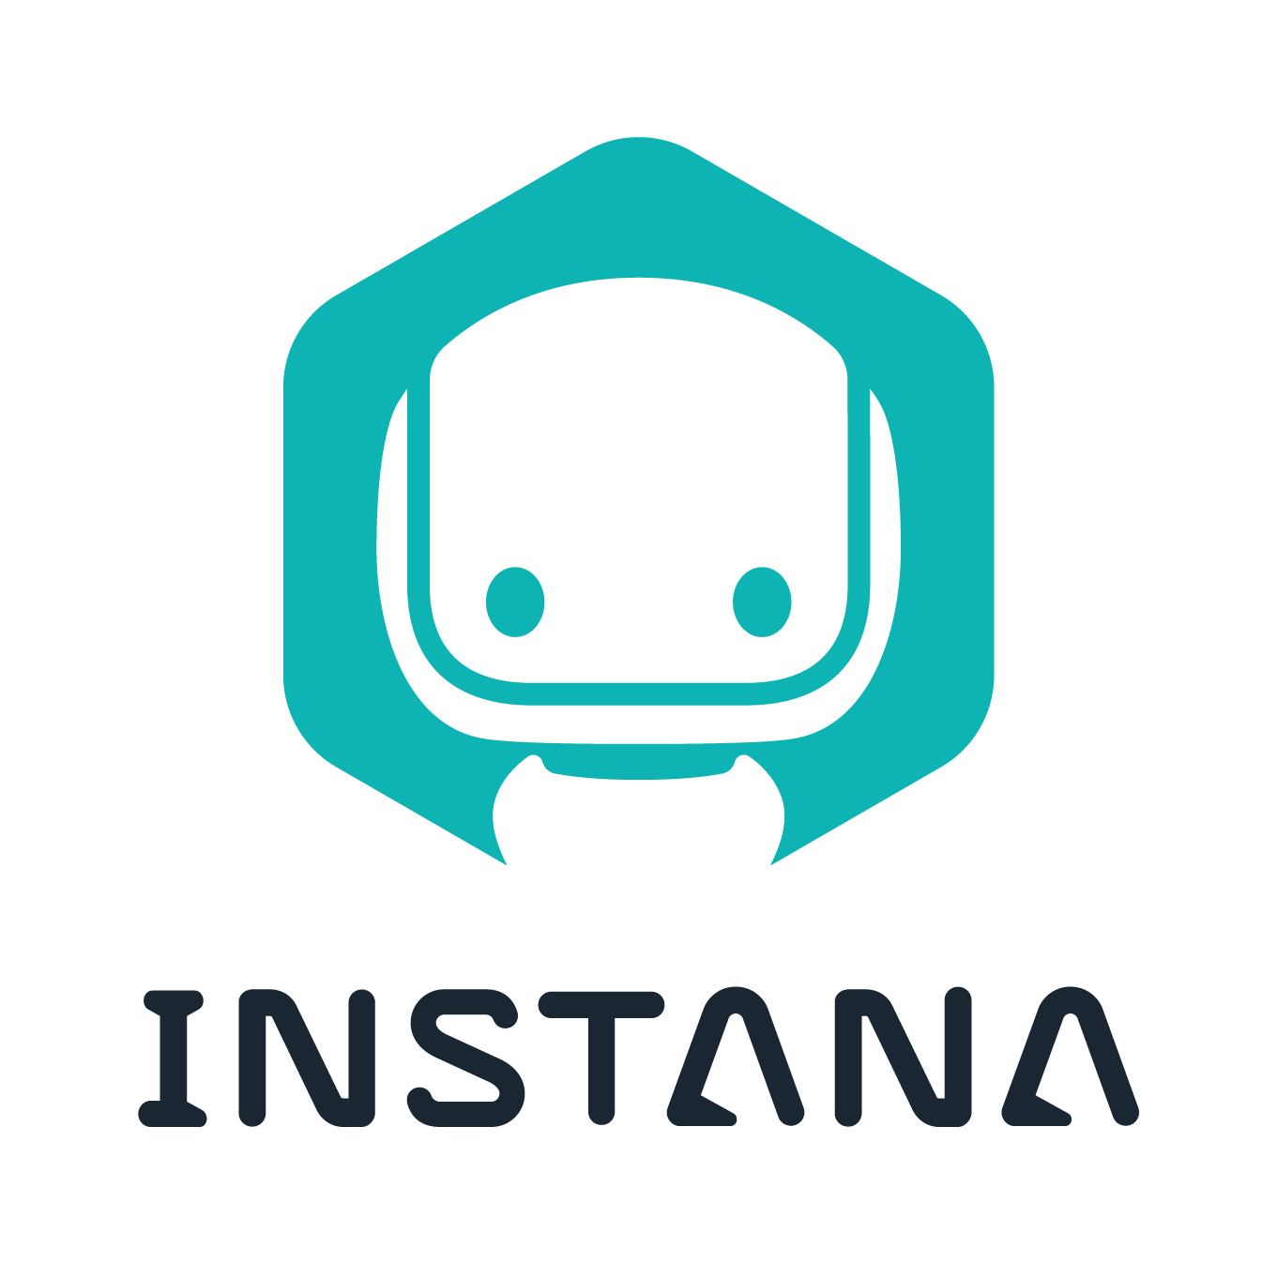
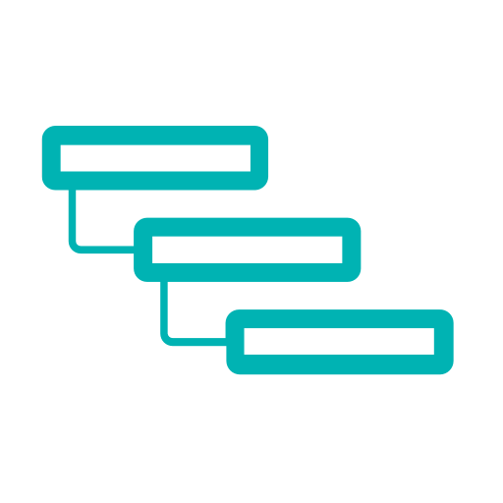


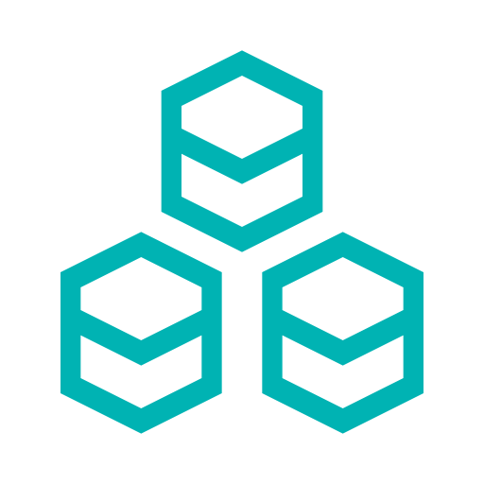

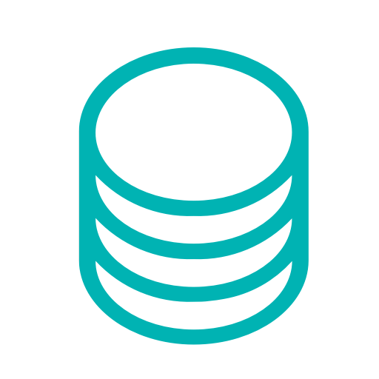

Infrastructure as Code
Container Orchestrations
Pods & Containers
Security
Services & Daemonsets
Monitoring & Alerting
Deployments
Infrastructure as Code
Reconciliation
Clusters
First APM solution with built-in Git-based management of Agent configurations
Governance & Compliance
Databases (Schemas)
& Messaging & others
Networking
& Virtual Hosts
Infrastructure
Layers
Cross-cutting
Concerns

Slide 14
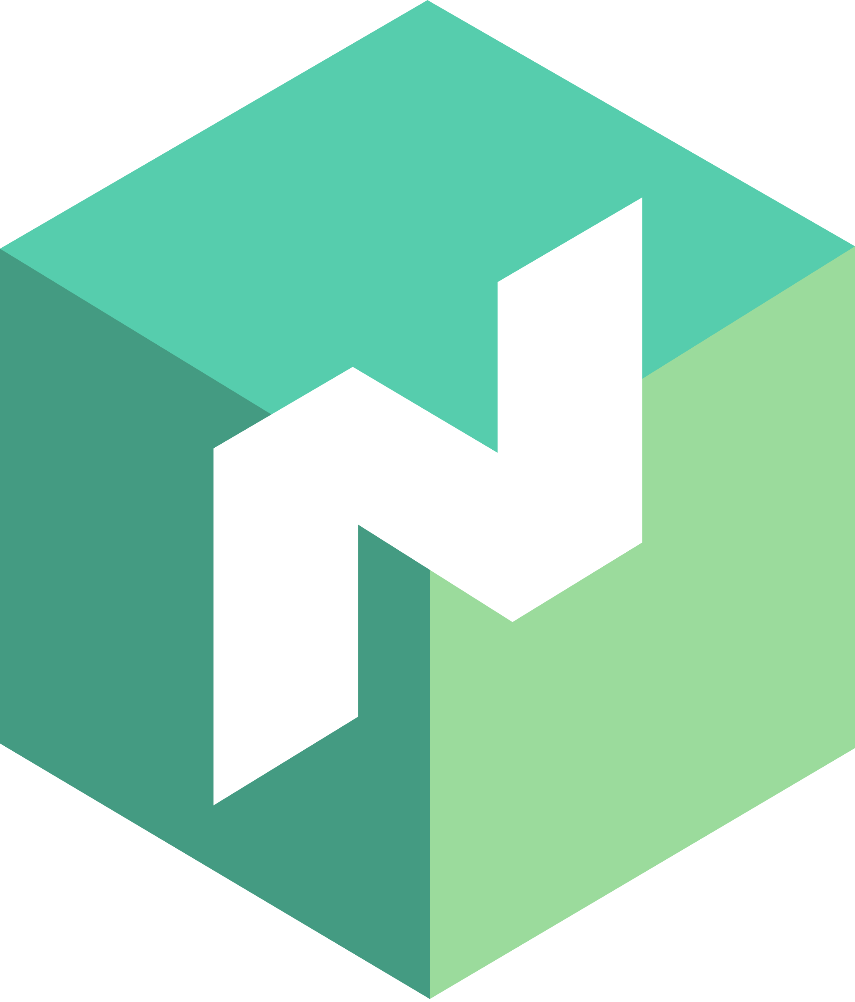
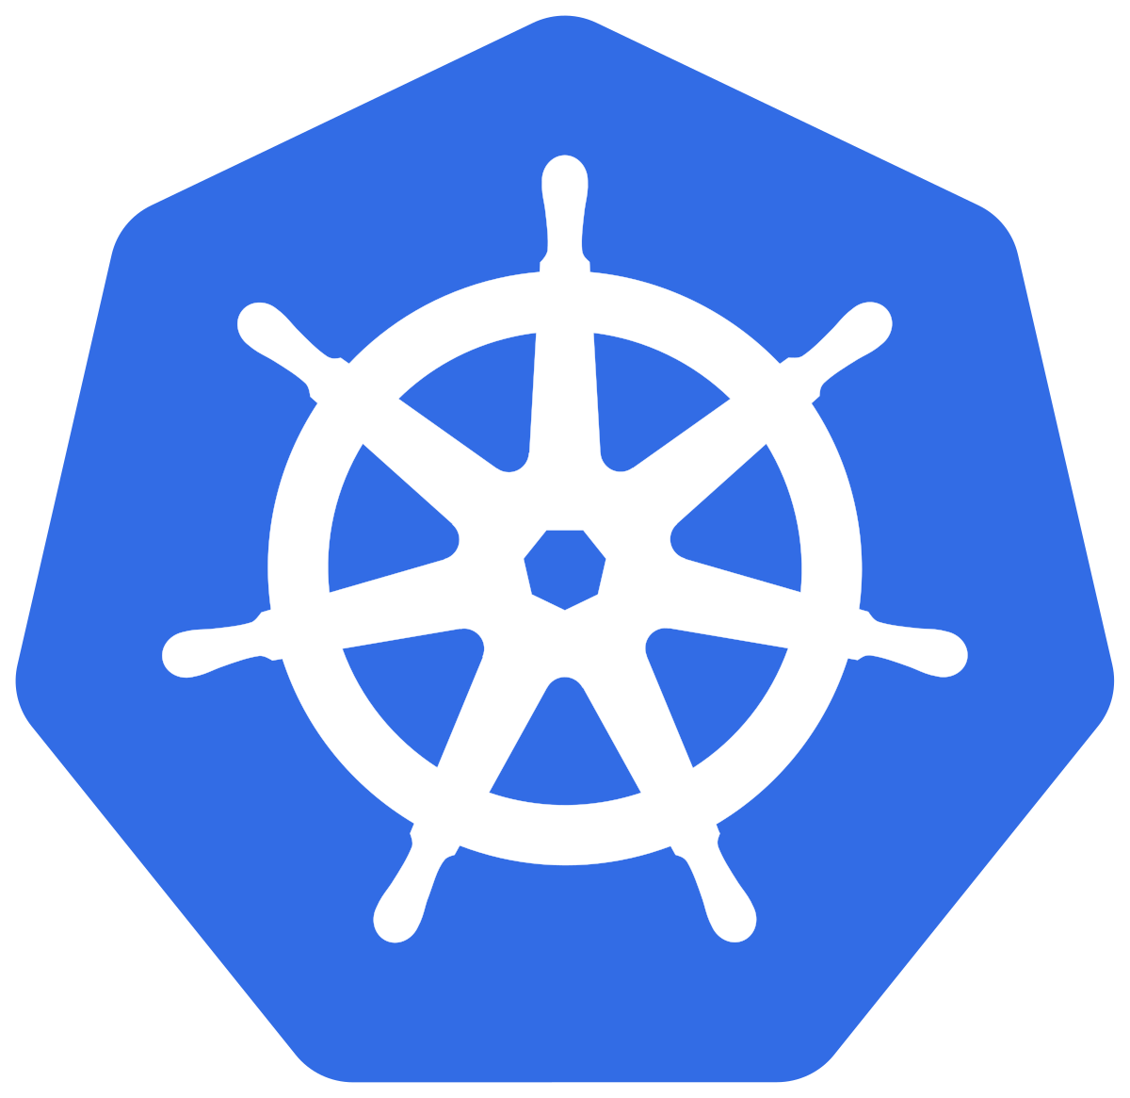
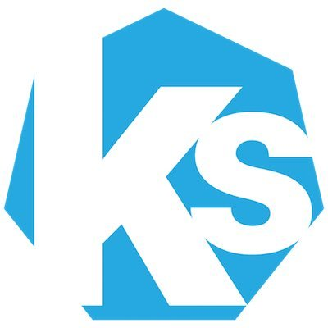
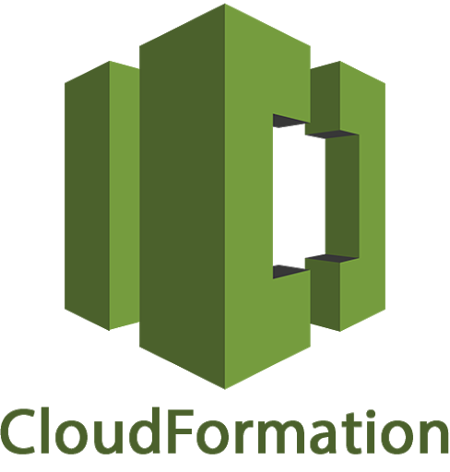


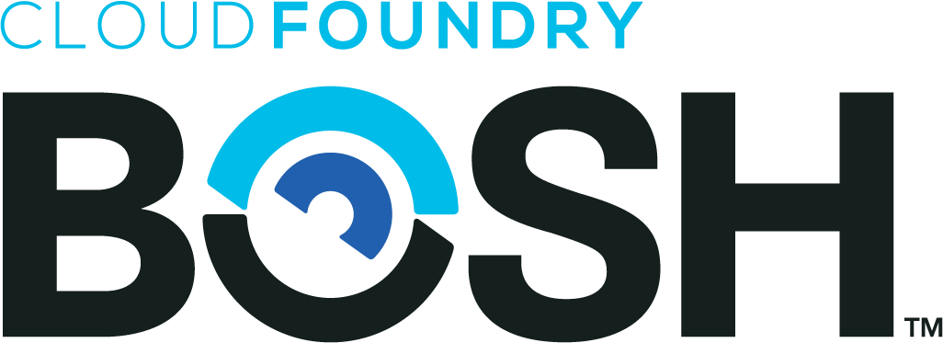
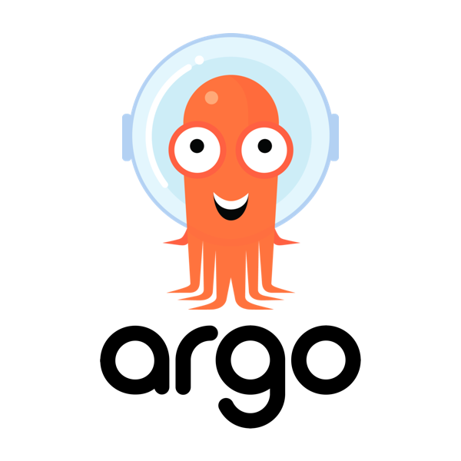
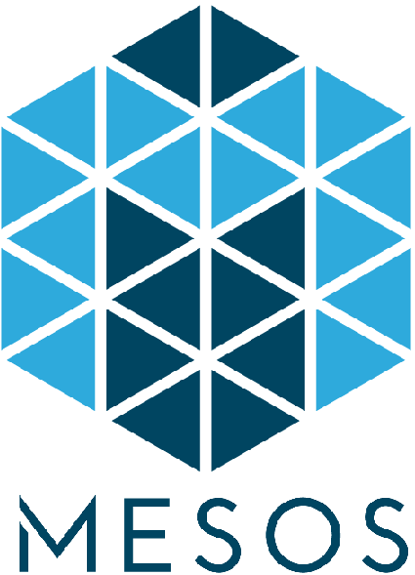
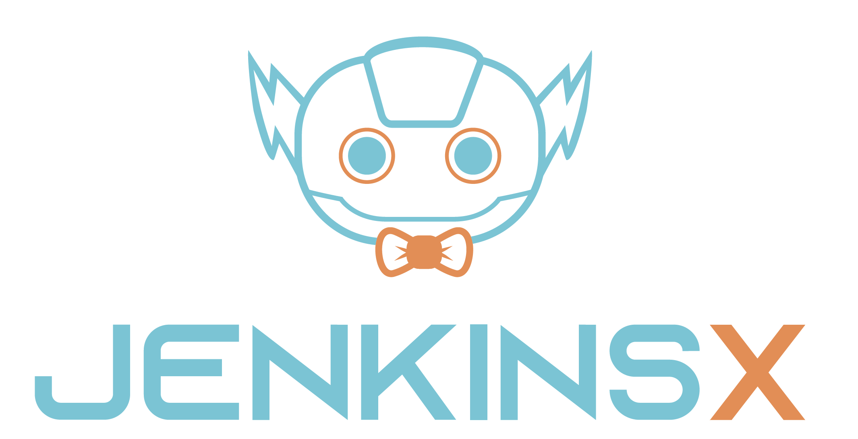




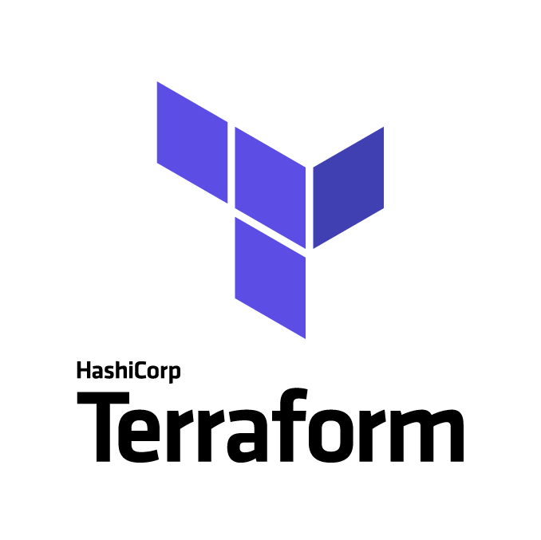

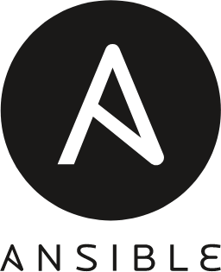
Can you do GitOps on...
Nomad
ksonnet
Google Cloud Deployment Manager
Tekton
Azure Resource Management
And many more…
(Watch “Kubernetes and The GitOps Face-Off”, by Ricardo Aravena & Javeria Khan for more in-depth analysis of the K8S ecosystem)
Pulumi
Notes:
Of course, when talking GitOps, most people immediately think of Kubernetes *CLICK* and the declarative nature of kubectl. There are a lot of Kubernetes-native options for GitOps *CLICK* to choose from.
But Kubernetes is far from the only one container orchestration that allows you do declare what you want to have running, see, for example, *CLICK* Nomad or Mesos. At Instana we have used Nomad a lot before migrating to Kubernetes, doing GitOps since early days.
And GitOps is really not limited to container orchestration. You may be using *CLICK* BOSH to manage VMs and what is running on them.
Or use, likely in combination with other tools, any of the Infrastructure as code offerings of the *CLICK* hyper-scale Cloud Providers.
Also, you may be using more generic tools, like *CLICK* Pulumi, Terraform, Ansible or Spinnaker.
Ultimately, *CLICK* if you can declare your desired state and there is an engine that performs reconciliation to keep reality in line with the desired state, you can do GitOps with it, it is then mostly a matter of how well integrate the workflow is.
Notice that many of the tools mentioned in this slide are not directly comparable with one another, but each may enable some aspects of GitOps depending on what you deploy where.

Slide 15
What GitOps is not

Slide 16

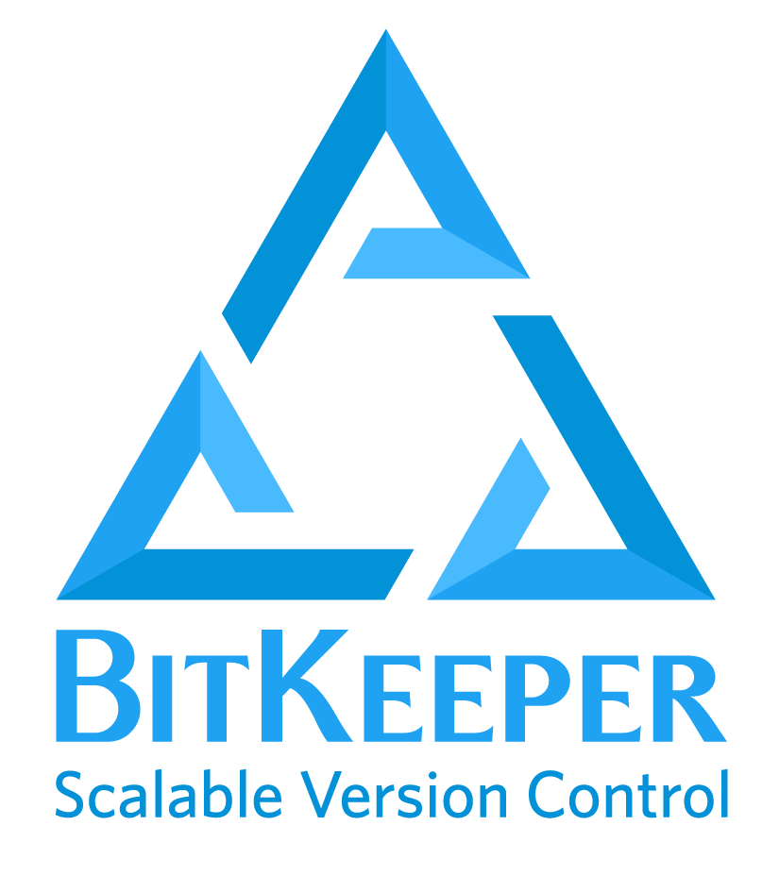


GitOps is not…
Necessarily using Git
GNU Bazaar
Notes:
No one says that Git is actually necessary to do GitOps.
Git is by far the most convenient because of the increasing amount of integration and tooling.
But, in principle, any version control system would likely do, depending on how hard it is to integrate with the rest.
Although, I have not recently met many people using other version control systems, and none of them using a GitOps workflow.
Ultimately, the “Git” in GitOps is just like saying “I am going to Google that” and then you search on DuckDuckGo or Bing: Git has become pretty much eponymous of “version control”.
It does not even need to be distributed version control, by the way.
* CLICK*
Although I get cold shivers when thinking of using SVN again in my life.

Slide 17
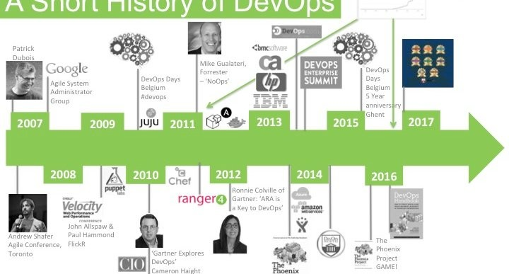
GitOps is not… A Revolution
GitOps is an evolution of previous practices:
  Extends DevOps with a single source of truth
  Infrastructure automation to the extreme
Enabled by a critical mass of declarative infrastructure
Credit: Helen Beal,
Continuous Delivery Foundation

Slide 18
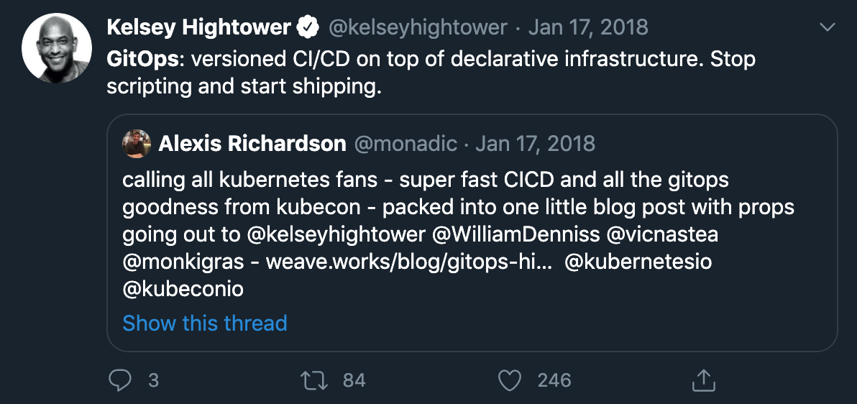
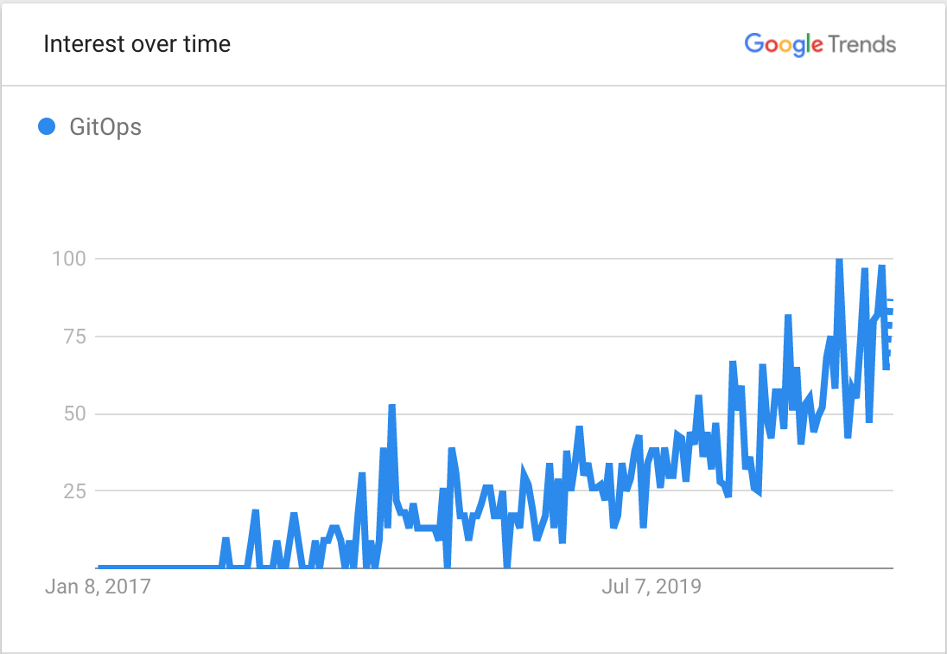
GitOps: A Timeline
2017: Weaveworks introduces GitOps as a set of best practices to manage cloud services
2019: GitOps picks up speed, most Infrastructure as Code, CI/CD tools, Versioning platforms and several orchestration tools talk of GitOps
2020: GitOps is spoken about pretty much everywhere in the Cloud-native community
Hightower
Divide
Notes:
The “Hightower Divide” is how, it seems to me, often topics surface in the global consciousness of the K8S community. When Kelsey tweets or talks about something, thanks to to his reach and general awesomeness, you can bet that the majority of K8S users will swiftly become acutely aware of that topic.

Slide 19
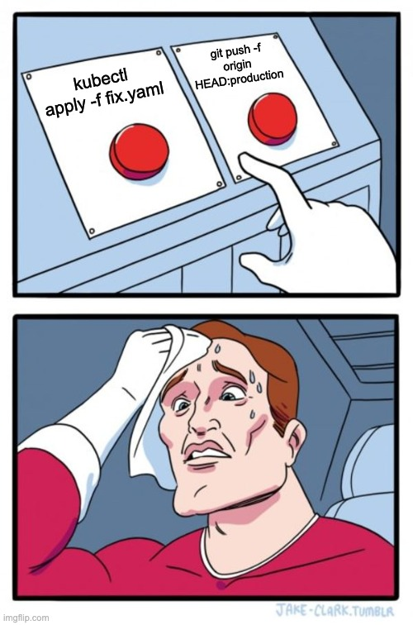
GitOps is not…
A Process to be Bypassed
Forsake applying changes manually
Or have your fix blasted away from reconciliation or the next change
Changes roll out a bit slower than you could via kubectl or ssh

Slide 20

GitOps is not… Using LATEST
Notes:
On the importance of using explicit versioning

Slide 21

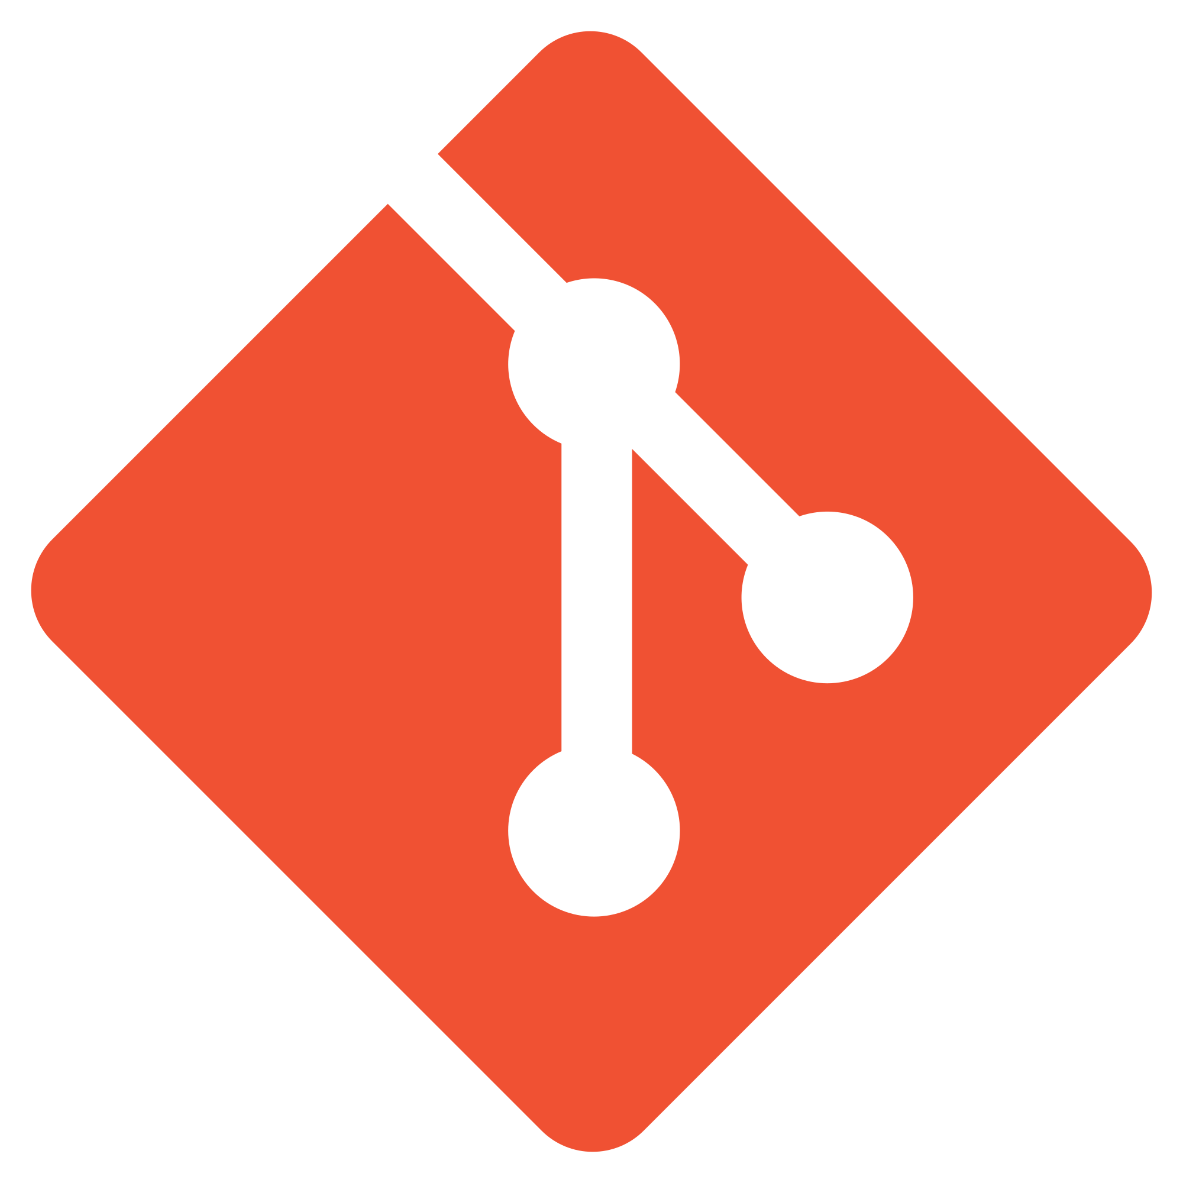
GitOps is not… Everything in Git
Declarative
Infrastructure
Container & Virtual Machine Images, etc.
Secrets
Notes:
The source of truth of the desired state is in Git but:
Container images live in Container Repositories
Virtual Machine images too!
Secrets must not live in Git!
And so on...

Slide 22

GitOps is not… A Monorepo
Notes:
A few years back, we all wondered in amazement at the fact that Google was having the overwhelming majority of their code in one single repository. And there were a lot of people that thought that it is a great idea. And maybe, for some it was, too.
But anyhow, depending on your GitOps tooling and workflow, you will likely have:
Different repositories for different infrastructure layers
Different repositories for source and configuration
Different branches for environment configurations
Different repositories for sources of different applications
...

Slide 23

GitOps is not… YOLO Merge to Prod
Notes:
Desired changes must be validated by the Pipelines we have been talking about:
For compliance, governance & security
For correctness (bugs, performance issues)
Staged developments with strong quality-based gate-keeping:
The faster you want to go, the surer your step must be
“You need to go slower to go faster”

Slide 24

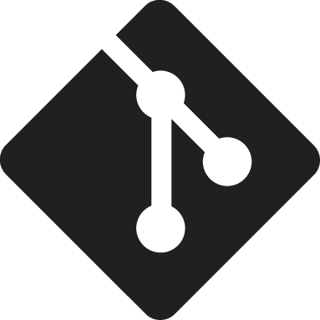
GitOps is not… Deploy From Git Every Two Weeks
Notes:
Muse on SAP Cloud Platform of yore

Slide 25
Gotchas

Slide 26

Going Forwards is Easier
than Backwards
Stateless applications are easy to deploy, but…
  The components must be designed to be both forwards and backwards compatible
Database schemas changes are still hard to revert
  And what do you do with the data you stored in there?
Events and Event Sourcing

Slide 27

Not all is Green in
Infrastructure Land
DNS changes take time to propagate (“it’s always DNS!”)
Long deployment times for Virtual Machines
Orphaned resources still cost you $$$
Notes:
Infrastructure management less mature than Software deployment

Slide 28

The Dark Side of Deploying Often
Peak resource usage at startup
More deployments => more peaks
Cache management
More cache flush
More work to keep cache warm
Notes:
Now, I do not mean to say that you should not deploy often. You should do it as much as you can. It’s a large part of the DevOps culture. But there are some hard problems you will have to face to get there.
First: resources...
Secondly. Remember that quote of Phil Karlton: “There are only two hard things in Computer Science: cache invalidation and naming things.”
*CLICK*
The more you deploy, the more you have to deal with caches…
By the way, I tried to make this work like the Star Wars titles, but it is 2020 and that effect is not yet built into Google Slides. That’s just too bad.

Slide 29
Summary

Slide 30
Key Takeaways
GitOps is a natural evolution of DevOps
  Predicated on declarative infrastructure
  Infrastructure includes your apps and everything underneath
  Described in a single, versioned source of truth
Excellent observability is a must to succeed at GitOps
You need a solid DevOps culture before stepping up to GitOps
(Too) Many tools to choose from
Dealing with Declarative Infrastructure is not always rosy underneath container orchestration

Slide 31
THANK YOU!
Meet Me in the Network Chat Lounge for Questions

