Slide 1
Using AI Powered Intelligent Test Automation to Achieve Continuous Testing
Eran Bachar, Sr. Product Management Lead
November 2020

Slide 2
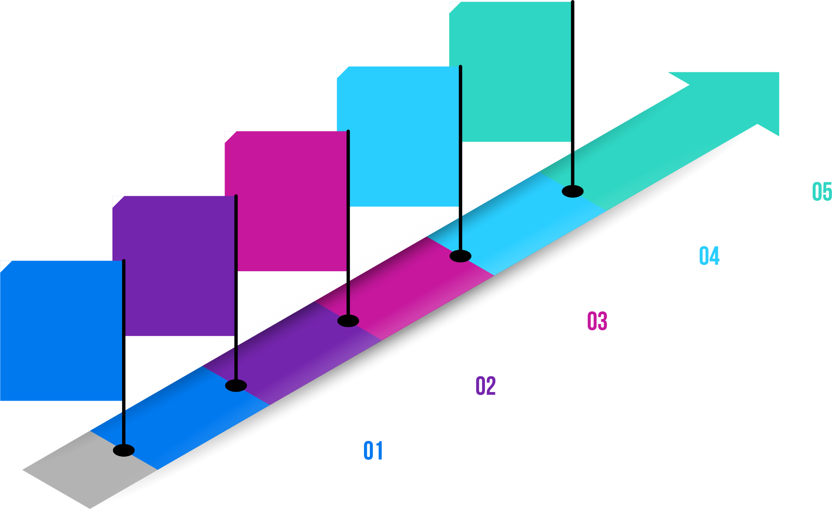
Complexity in Testing
Demands Placed on Testing & Delivery Teams is Increasing Exponentially
AUTONOMOUS TESTING, MACHINE LEARNING, AI
ALL ABOUT
SCALE
Work Smarter, Not Harder
The world has changed and so should automation
MORE ROBUST AUTOMATION & OPEN SOURCE
The Future
# of Tests
More ‘Things’
???
LIGHTWEIGHT AUTOMATION TOOLS
2010 - 2020
Digital first, end user drives everything
Tens of
thousands
MANUAL TESTING
2000- 2010
Web is king but evolving, mobile is emerging
Thousands
1990 - 2000
Increased Desktop ecosystem and emerging Web. Limited automation was fine
Hundreds
1980 - 1990
No real need to scale testing beyond manual. User experience did not really exist. Limited variety
Tens
Notes:
Walk the talk of the slide, lead to the next slide saying that testing should be smarter but it’s part of the Devops which quality is the core of successful devops…

Slide 3
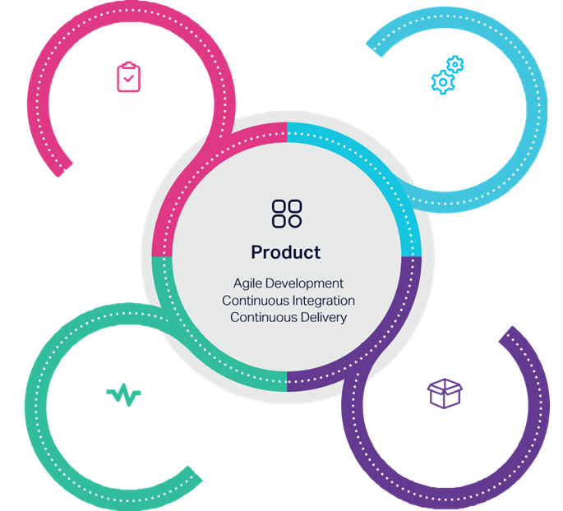
Deliver at high speed with low risk by
putting quality at the Core of DevOps
Notes:
In the digital economy, winning the high-speed race to innovate requires a high-speed approach. With Micro Focus, you can unleash the power of DevOps across your hybrid IT landscape—quickly bringing innovative ideas to life at the pace your business demands.
Our solutions help:
Reduce operational friction by optimizing value streams from request to business value.
Boost business confidence by engineering quality and security into every application.
Deliver better outcomes by leveraging feedback and analytics to continuously improve.
Now you can deliver at high speed with low risk.
-------------------------------------
Here talk about the continuous testing and the need to have Test Automation as core of it … and let’s see what are the two things that needs to ensure in order to have successful automation.

Slide 4
Automation is an accelerator for quality
Maximize
Test Automation coverage rates
Minimize
Test Automation maintenance costs
Design
Code
Test
Deploy
Code
Test
Deploy
Code
Test
Deploy
Methodology
Automation breaks frequently due to fragile identification
Notes:
There are four key benefits of leveraging in test automation:
Reduce maintenance costs by 70% or more
Increase automation coverage by 30% or more
Increase speed of test development by a factor of three
Extend reach so everyone on the team can test

Slide 5
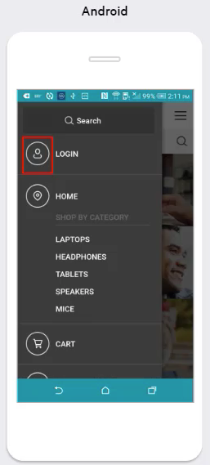
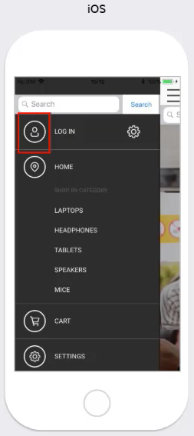
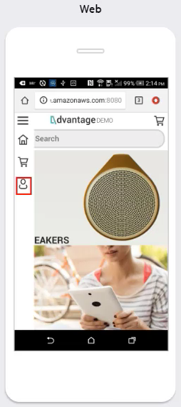
An example from today’s reality
Use Case | Automate a business process of buying an item in an e-commerce application The application is available as native mobile app as well as hybrid one
Challenges | THREE scripts are required to automate the same flow! -> TIME TO MARKET CHALLENGES Changes in the application break the automated script -> HIGH MAINTANANCE COST
Android
iOS
Mobile Web
Notes:
Let’s take a look on relatively simple example that I’m pretty much sure your customers are facing on a daily basis.
Need to automate a simple test of buying an item.
Need 3 different scripts and the challenges are…

Slide 6
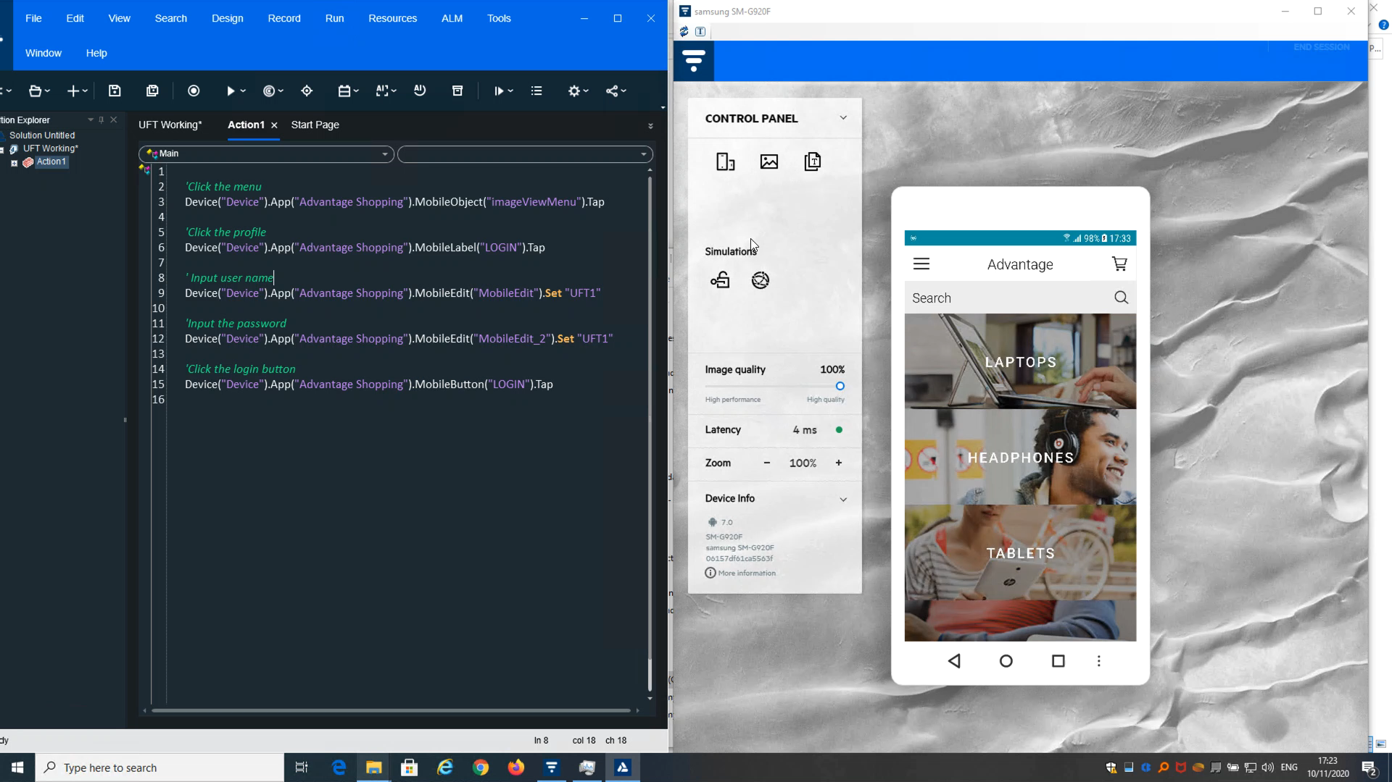

Slide 7
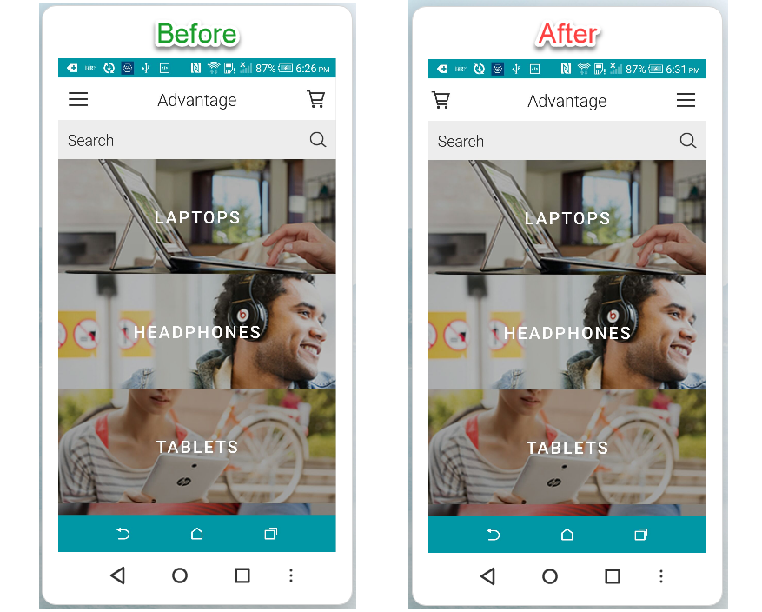
Let’s introduce a small change to the application
Dev Commit
Before
After

Slide 8
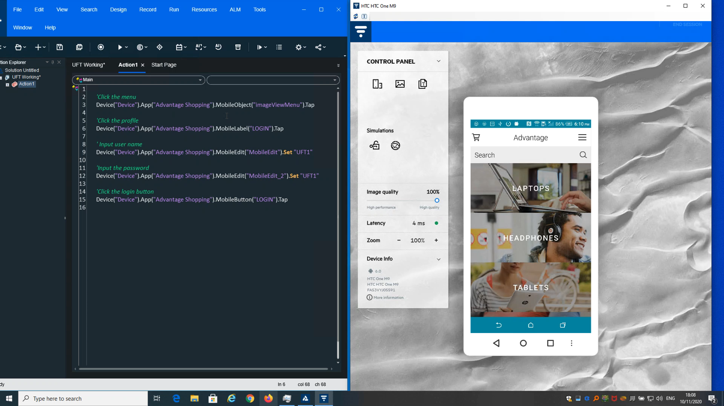

Slide 9
Why is it happening?
Object Identification is based on the physical object properties
Changes in the application implementation impact the underlying object identifiers which leads to automation break
What if we could automate the business process as a human (vs. a machine) “sees” it?

Slide 10
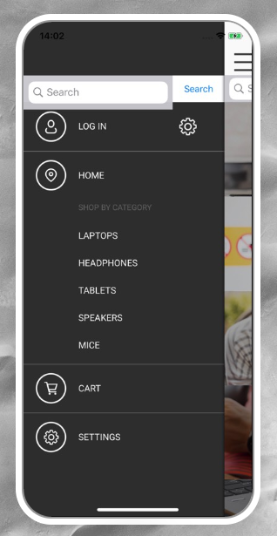

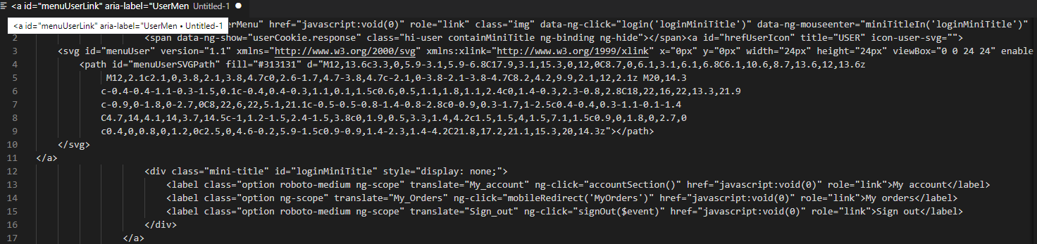
What if we could automate test as a human does?
Mobile Devices
Desktop Browsers
Type ‘17t’ to the input field
Click the ‘profile’ button
Click the ‘search’ button
Click the ‘profile’ button
Click the ‘profile’ button
Click the ‘search’ button
Click the ‘mice’ text
Click the
‘cart’ icon

Slide 11
AI Major Research Areas
Knowledge
Representation
Natural Language
Processing
Social
Intelligence
Reasoning,
Problem Solving
Machine/Deep
Learning
Motion and
Manipulation
Planning
Perception
General
Intelligence
Notes:
Reasoning, problem solving
Knowledge representation
Planning
Learning
Natural language processing
Perception
Motion and manipulation
Social intelligence
General intelligence

Slide 12
AI Major Research Areas
Natural Language
Processing
Natural Language
Understanding
Test case design
Machine/Deep
Learning
Supervised Learning
UI Elements Classification
Monitoring Aspects
Perception
Computer Vision
UX/UI object recognition
Notes:
Reasoning, problem solving
Knowledge representation
Planning
Learning
Natural language processing
Perception
Motion and manipulation
Social intelligence
General intelligence

Slide 13





Micro Focus functional testing AI capabilities
Computer Vision
Neural Networks
Natural Language
Identify objects the same way as a human does
Interact with and manipulate objects naturally
Write tests using
plain English (almost)
“Translator”
“Brain”
“Eyes”
Notes:
We equipped UFT with AI technology as follows:
Using computer vision to identify the different elements the same way human does and not the traditional way of ‘underlying identifiers’
Using a Neural Network that will understand the element and take decision how to interact and manipulate with
We’ve embed NLP capabilities, so test can be written in very simple way, almost like plan English!
And… we’ve leveraged the power of our Install base and provide also feedback mechanism, so if something won’t work, can easily share feedback with us directly form the tool and we will update the model so next time the element will be recognized. Ultimately, upon having this solution using by our mass users and having them proving feedback to us, our AI engine will be the smartest tester in the enterprise market.

Slide 14
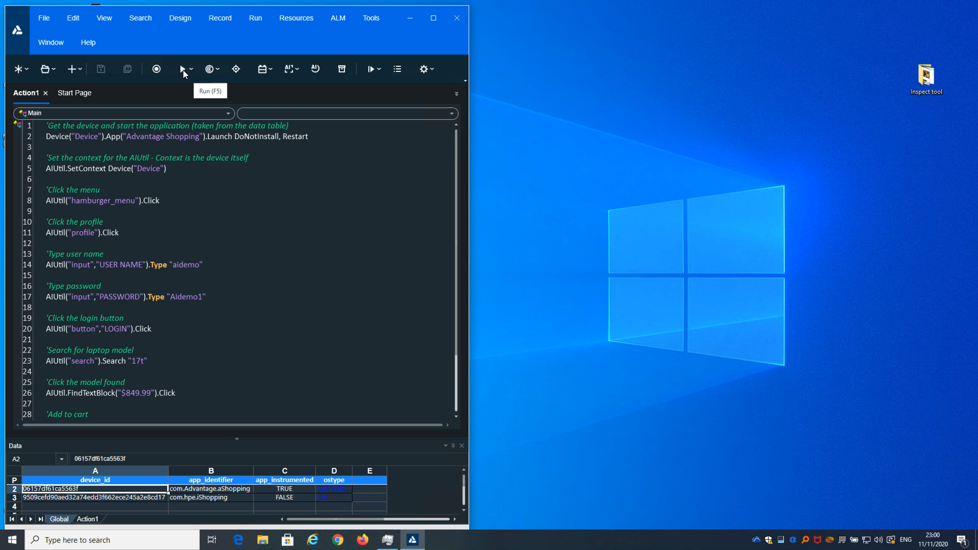

Slide 15
Key benefits of leveraging AI in test automation
70% or more reduction in maintenance costs
30% or more increase in automation coverage
3X increase in test development speed
Extend reach so everyone on the team can test
Notes:
There are four key benefits of leveraging in test automation:
Reduce maintenance costs by 70% or more
Increase automation coverage by 30% or more
Increase speed of test development by a factor of three
Extend reach so everyone on the team can test

Slide 16
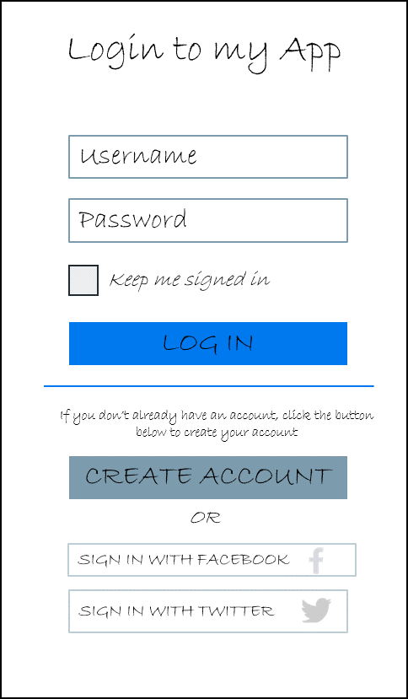
“Extreme Shift Left” - create tests at the design phase
Maximize
Test Automation coverage rates
Minimize
Test Automation maintenance costs
Design
Test
Code
Test
Deploy
Code
Test
Deploy
Test
Deploy
Methodology
Code
Code
Code
Create and Design Test Automation assets on Mockups

Slide 17
Thank You

